Slide 1
Land cover map center pivot trials planet labs imagery
Jan 31, 2018

Slide 2
Planet Imagery for land cover classification

Slide 3
Validation with commercial high resolution satellite imagery
Requested quote from Satellite Imaging Corp (QuickBird) – but was directed to PlanetLabs
Images searchable on LandInfo:
GeoEye-1
WorldView-1, to -4
IKONOS
SPOT 1- 7
RapidEye
PlanetScope/Dove (Planet Labs)
QuickBird (Planet Labs)
Planet Labs satellites
PlanetScope (Planet Labs, 3m)
QuickBird (Planet Labs, 5m) – requested QuickBird quote from Satellite Imaging Corp, redirected to PlanetLabs
Prices:
SPOT 6: $2.38/km2 with a minimum order of 100km2.
RapidEye: $1.28/km2 wit minimum order of $5,000
WorldView2: $12.25/km2

Slide 4
Purpose of Planet images:
Validate or adjust timing information (therefore need a mix of DC, SC soy across space and years; high temporal resolution; use soy training points to pinpoint which fields to use)
Validate SC vs DC, because it’s hard to discern them right now (therefore need a mix of DC, SC of SOY – should be relatively easy just from picking randomly in a region known to be soy based on soy training points)
Mato Grosso, a lot in Matopiba, and some in central – because most of soy training points are in Mato Grosso
Mix of years: 2014 because that’s the ‘central year’; after 2015 to be able to calibrate to Sentinel 2; before 2014 out of interest
What’s soy vs what’s not soy – harder to do, figure out if this distinction is actually needed
Which Planet satellite to use?
Satellites: 4 band PlanetScope, RapidEye Ortho, PlanetScope Ortho.
Want satellite data source that’s calibrated/ok to cite in literature
(Michael et al, 2018) : used PlanetScope (3m), compared reliability to NDVI images from Sentinel-2. downloaded data in two formates: as PlanetScope images and as Ortho Scene Product images, both with RGB and NIR. Calibrated Planet’s vegetation indices using in-field measurements. Compared PlanetScope to Sentinel-2A because it’s more reliable in terms of signal-to-noise and radiometric characteristics
How much we want to calibrate depends on whether we need to discern soy from nonsoy in Planet imagery, vs just want to look at timing and SC vs DC, assuming we know where soy is

Slide 5
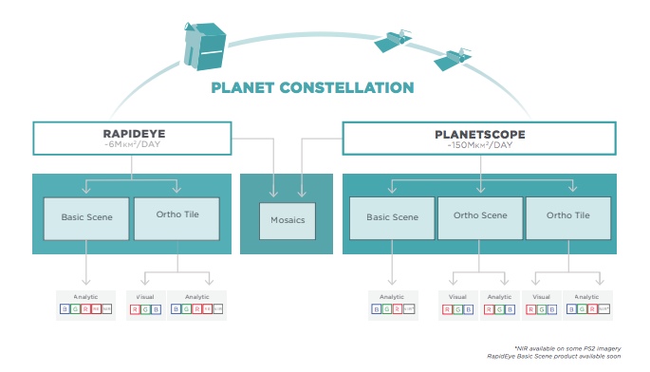
Which satellite data product to use?
From Planet’s Imagery documentation: https://www.planet.com/products/satellite-imagery/files/1610.06_Spec%20Sheet_Combined_Imagery_Product_Letter_ENGv1.pdf
Ortho Tiles: core produce line, available in Visual and Analytic product formats
RapidEye: since 2009
Planet operates PlanetScope (PS) and RapidEye (RE)
PS imagery is captured as a continuous strip of single frame images known as ‘scenes’; can be acquired as a single RGB frame or a split-frame with a RGB half and a NIR half. Three product lines for PS imagery: Basic Scene (scaled Top of Atmosphere radiance at sensor and sensor corrected product – designed for users with advanced image processing and geometric correction capabilities, not orthorectified or corrected for terrain distortions). Ortho Scenes are single-frame image captures with additional post processing applied. Ortho Tiles are multiple Ortho Scenes in a single strip that have been merged and then divided according to a defined grid.
PS Ortho Scene: orthorectified, scaled Top of Atmosphere radiance (at sensor) for analytic and visual applications. The images are a series of overlapping framed scenes, not organized to any tiling grid system
PS visual ortho scene: orthorectified and color-corrected, attempts to optimize colors as seen by the human eye, can be used for cartographic and visualization purposes; eliminates perspective effect on the ground, restoring the geometry ofa vertical shot. Sun angle correction is applied. Only has RGB
PS analytic ortho scene: are multispectral products, accurate geolocation; removed terrain distorions and is from geometry of a vertical shot. Is optimal for land cover classifications; is radiometrically corrected. Has RGB.
PS ortho tiles: individual 25km x 25km tiles, can be used for cartographic purposes (however, how do you know that multiple dates aren’t represented in a single tile?). Is optimal for vegetation indices, land cover classifications, etc.the analytic (not visual) version has GRB and NIR
PS Ortho Tile: radiometric and sensor corrections applied, projected to UTM projection (product level 3A)
RE basic: similar to PS basic, don’t use it. RE ortho tile: radiometrically, senosr and geometrically corrected. The RE visual ortho tile is orthorectified and color corrected. RE analytic ortho tile has RGB, NIR and red edge. RE visual doesn’t have NIR. Analytic product has top of atmosphere radiance correction.
Seems like tiles are on the same date
TAKEAWAY: go for analytic scenes or tiles for both PlanetScope and RapidEye

Slide 6
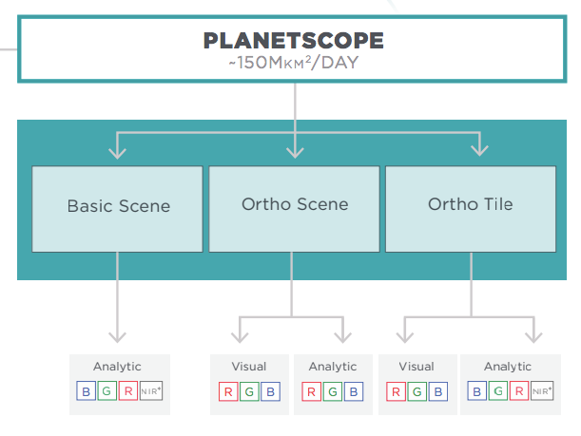
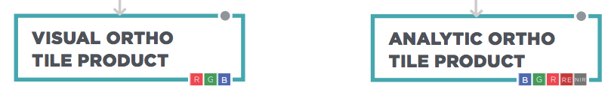
Note, band order changes with visual/analytic images
Rapid Eye band order

Slide 7
Can we assume land cover classification can tell where soy vs not soy is?
If so, can just use Jake’s land cover map to pick out soy areas in Planet Labs
If not, either need to classify soy as a first step, or use CAR polys we know are soy, or use soy_pts_1 (especially in Matopiba)
Test using GEE file LandCover/Soy vs Nonsoy Classification
Want to make sure true positive rate is high and false positive rate is low (where positive = soy SC + soy DC)
TAKEAWAY: when SC and DC soy are combined into a single category, accuracy goes up significantly, e.g. from 70-85% to 95%. This indicates the majority of the error is due to SC vs DC soy, not soy vs nonsoy. However, false positives are very high and there’s not a lot of training points to improve it.
For Mato Grosso
Year | Accuracy | True positive | False positive
2014 | 95 | 453/(453+17) | 7/(11 + 7)
2003 | 92 | 348/(348+13) | 16/(14+16)
2004 | 90 | 324/(324+23) | 10/11
2007 | 96 | 397/(397 + 2) | 14/(14+7)
2017 | 96 | 412/(412 + 8) | 9/(9+8)

Slide 8
Planet image selection
Want images that are definitely on soy
Want images in Matopiba, in places with very heterogeneous fields, single and double cropped
Want images over multiple years with high temporal resolution
First set of images: select polygons from Matopiba survey because we know there’s soy in those polygons
that contain only soy (according to Jake’s map); no other agri
2013 to 2016
High temporal resolution
Chosen Matopiba polys (plus one hand drawn over large soy area):
COD-IMOVEL = PI-2208908-F1596ADFF5024F9888CFAC4F2920F1DF
COD-IMOVEL = MA-2112001-0717432755244F11959BCC742EE519DF
COD-IMOVEL = BA-2928901-87522FFA491C4974A534FF292712263C
Export areas as shp files to GEE Drive Planet Labs Imagery/shp_for_planet_selection and load into Planet
Look up how to connect Planet and GEE

Slide 9
Land Cover Classification (center pivot)

Slide 10
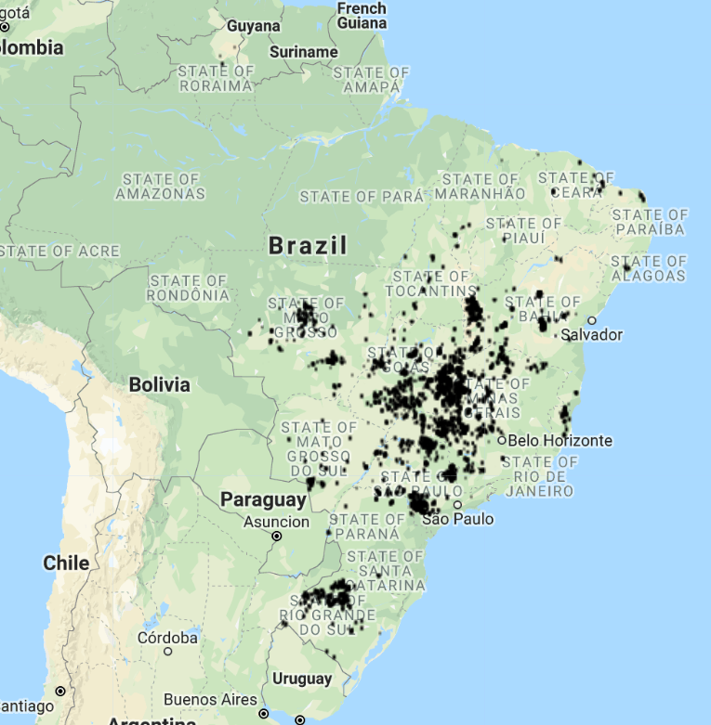
Center Pivot Edge detection
Set up accuracy assessment/method tuning
Randomly select 10 center pivot locations in 2014
Take 2km radius circle around the randomly selected center pivot
Do reduceToVector (computationally intensive!)
Check overlap/nonoverlap of centroids with reported 2014 center pivot depending on:
Kernel size(s)
Landsat 8 day vs 32 day
Date of Landsat image
Landsat image edge cleaning method
Location in Brazil
2014 reported center pivot
In GEE: LandCover/Center Pivot Classification

Slide 11
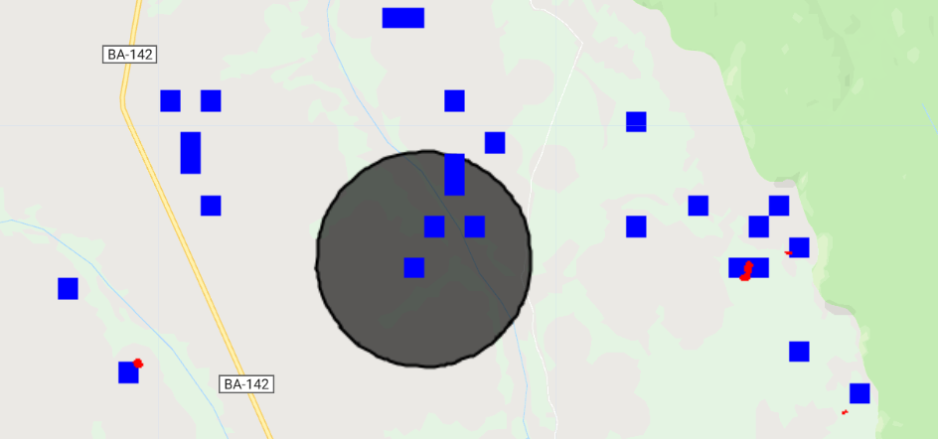
reduceToVectors() and scaling notes
The number of detected CP depends on the scale used during reduceToVectors()
The ability to ‘see’ the red detected image pixels also depends on the scale; did reproject() to 500m to see dots that didn’t appear at 30m
For the same center pivot image, when add area of detected center pivot at 30m scale, get area of zero; at 500m scale, get area of 1km2. why?
NOTE that because I’m using a temporal composite, the image.projection().nominalScale() is 110 km/pixel!
Why do the result of reduceToVectors() and reduceRegion() change based on the scale used?
Why do the red dots disappear from Map.addLayer() at low scales (i.e. at 493m, it disappears but at 495m it’s still there). Similarly, at 494m the reduceregion() area is zero; at 495m it’s about 1km2
Blue = detected CP pixels, reprojected to 500m scale
Red = ‘original’ detected CP pixels (not reprojected)
Cirlce: = 2km buffer around randomly chosen reported CP.
Similarly, no CPs were ‘detected’ at 30m reduceToVectors, but four were detected at 500m reduceToVectors
In GEE: LandCover/Center Pivot Classification

Slide 12
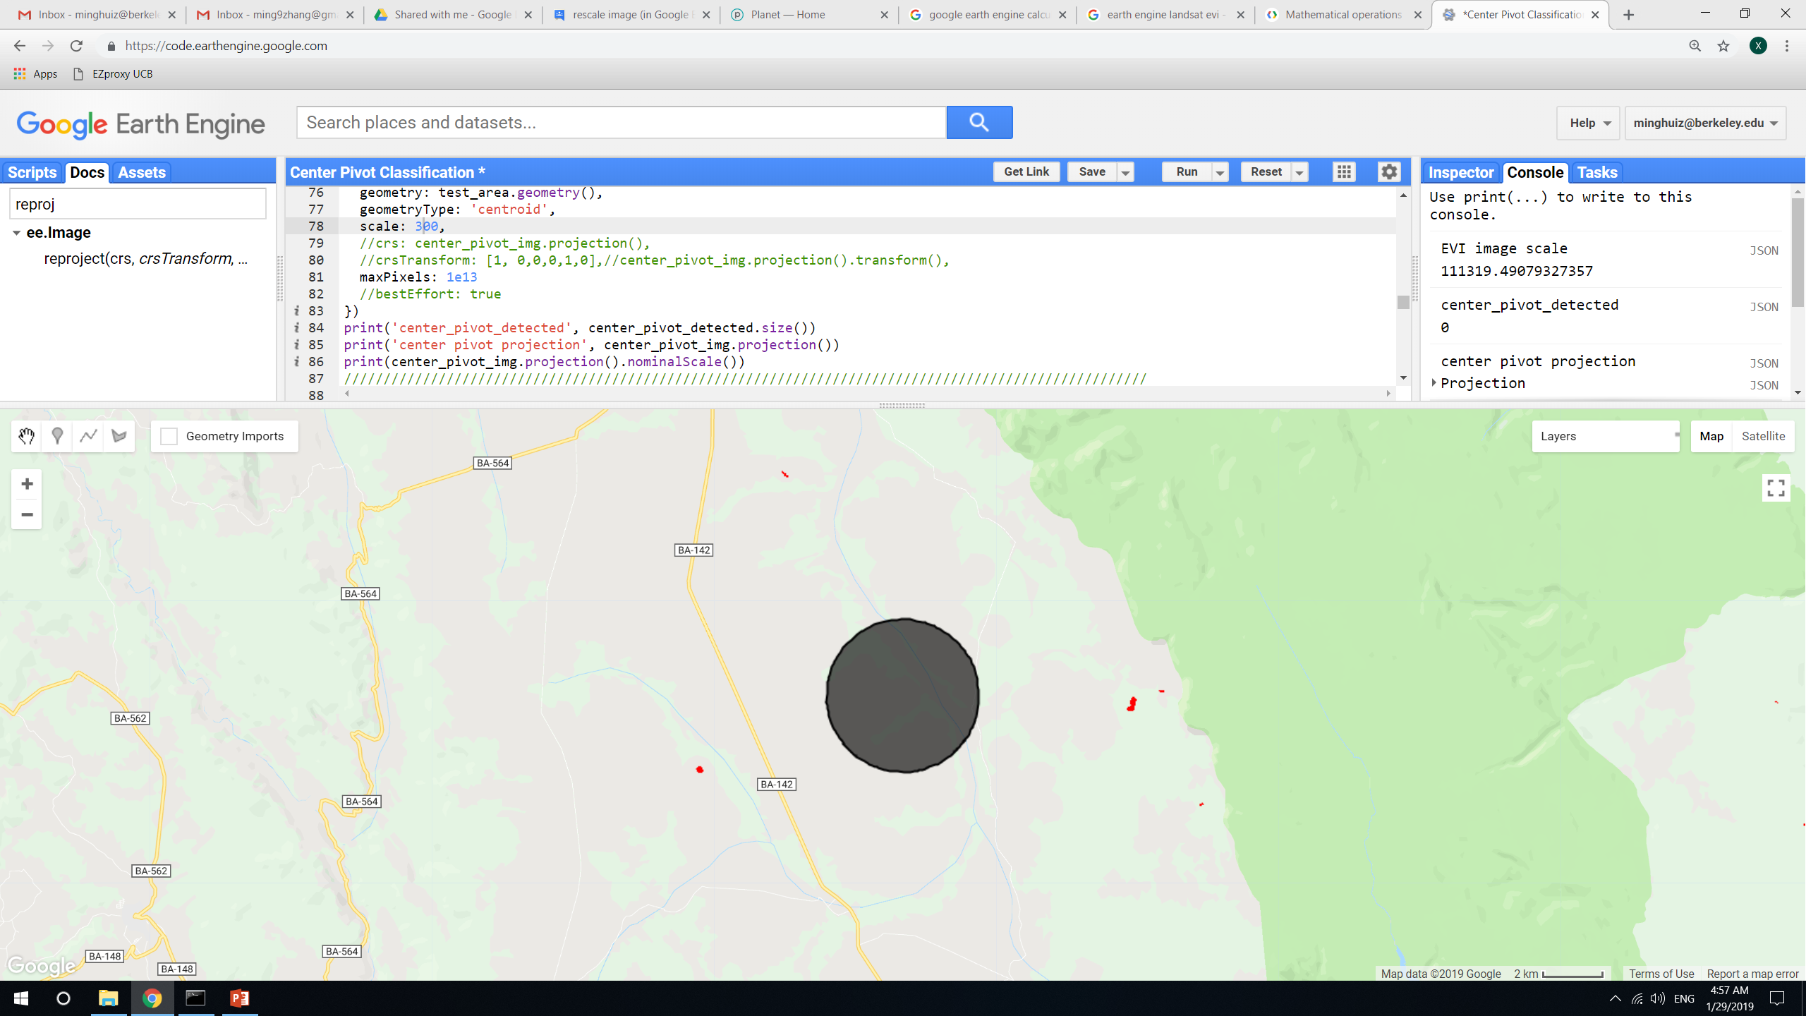
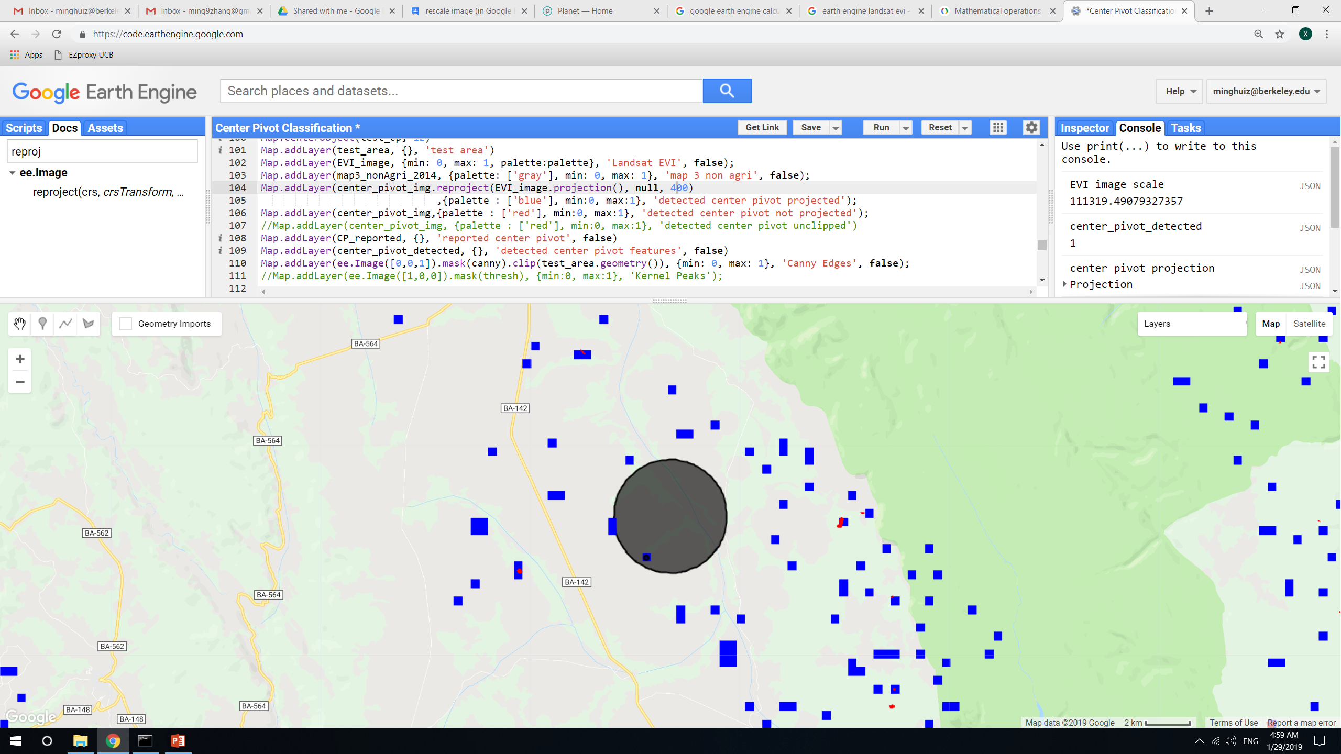
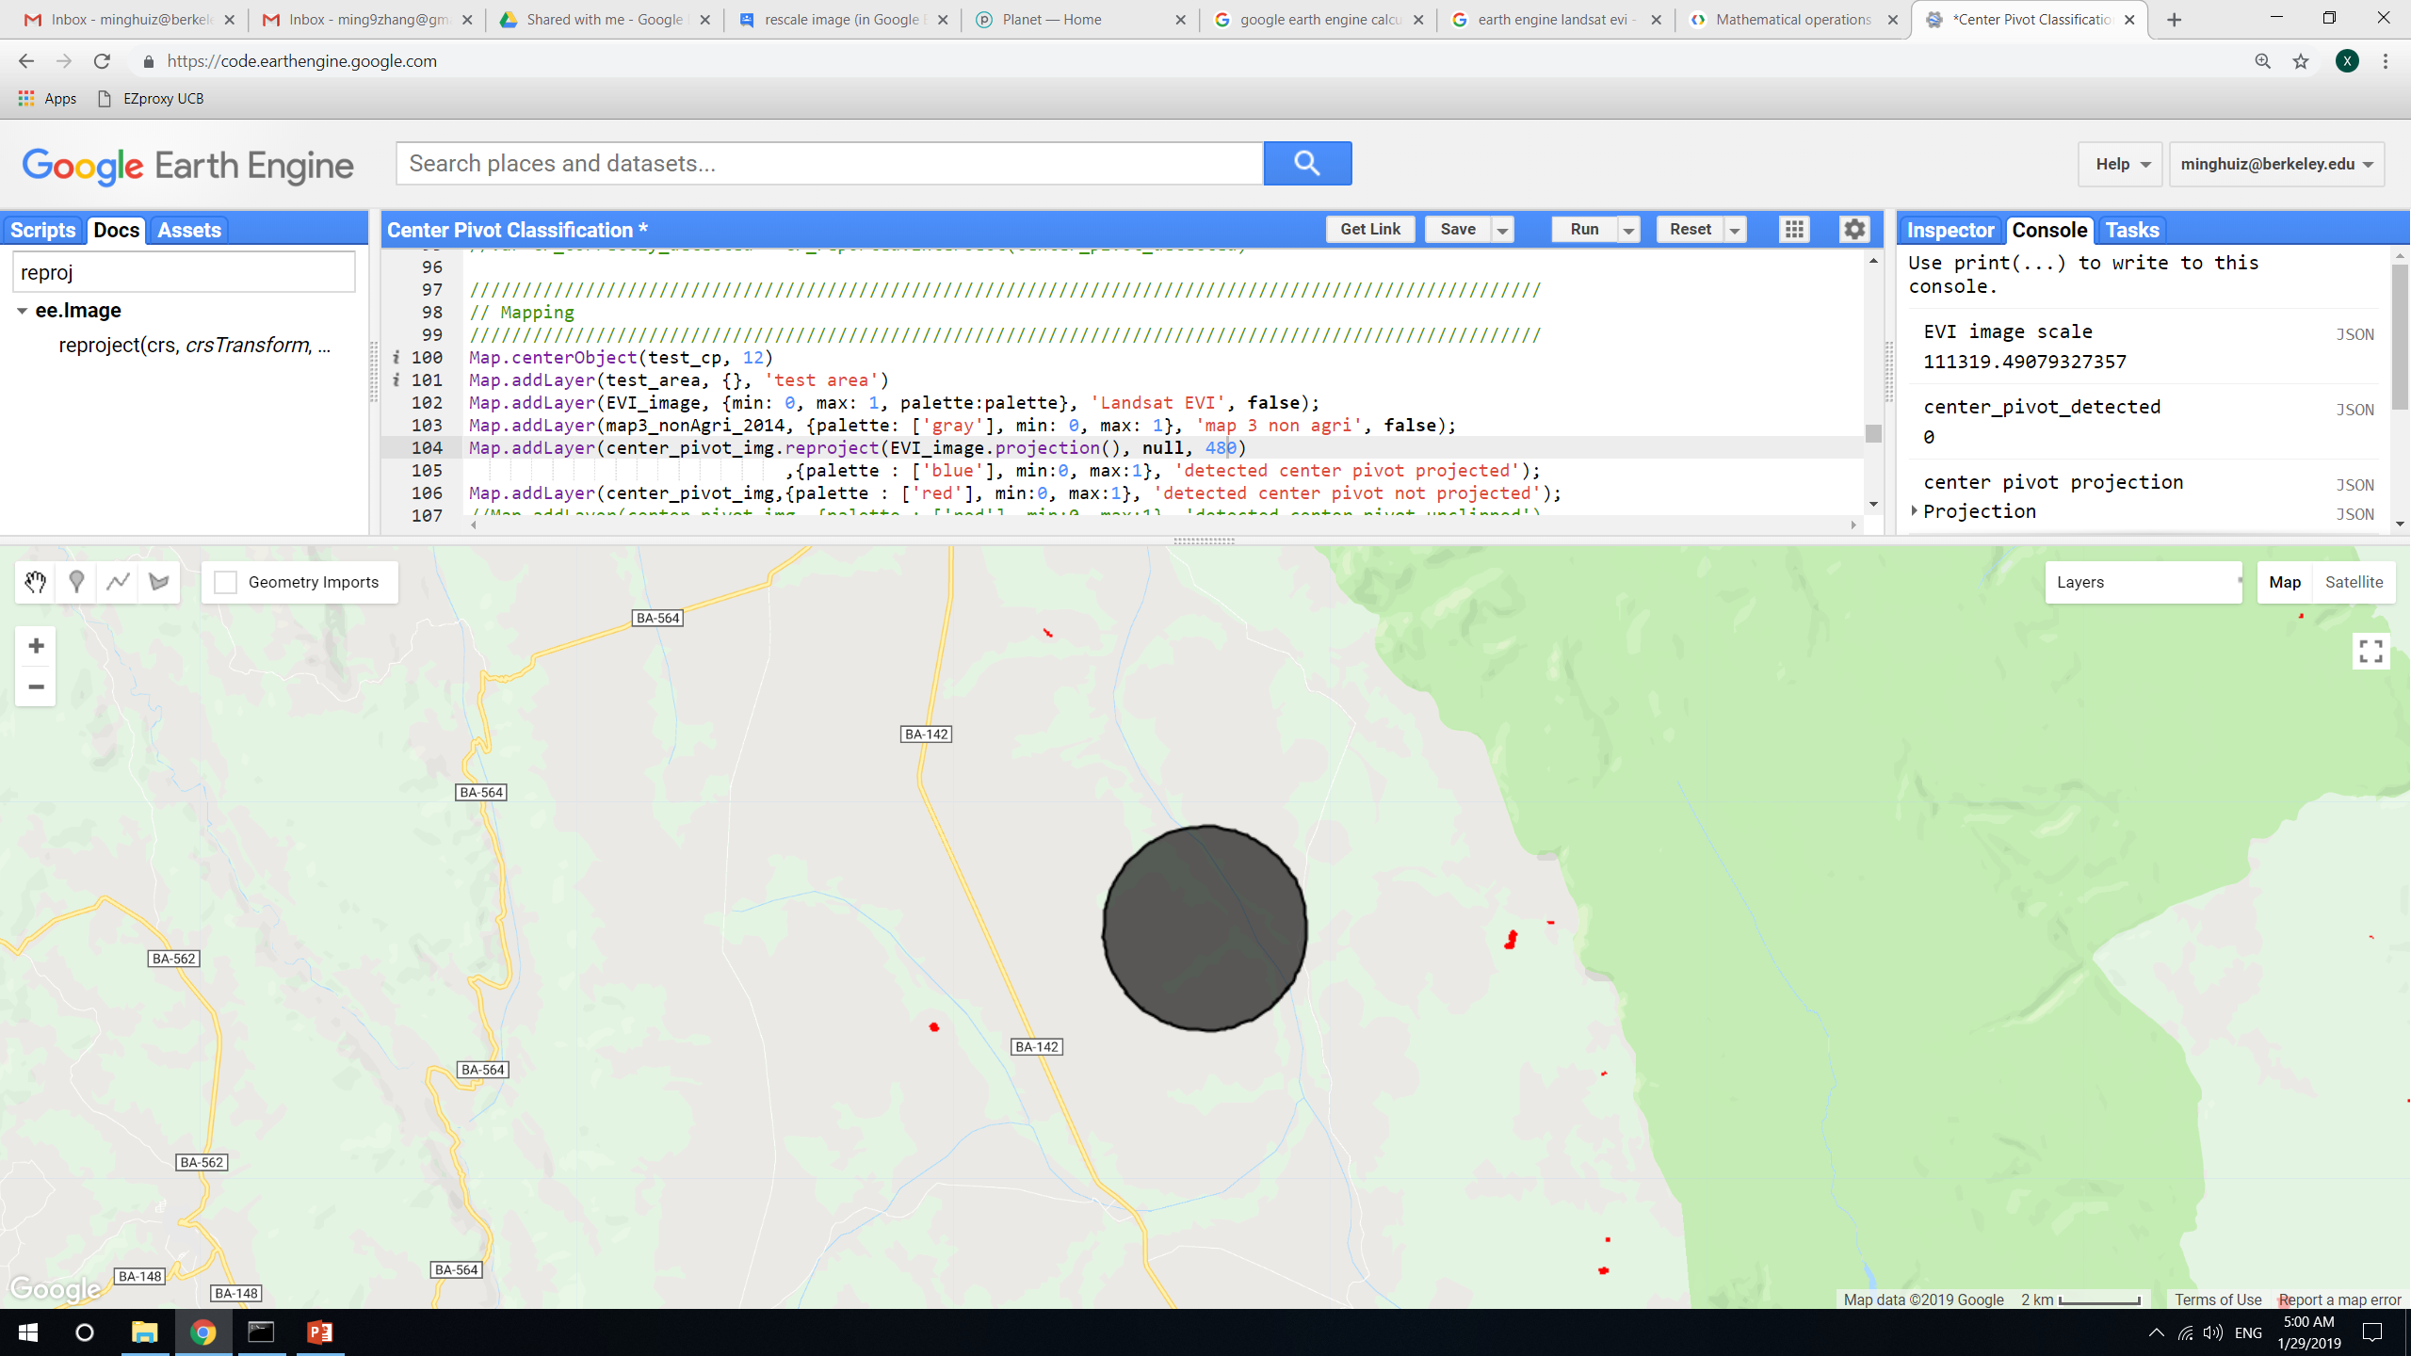
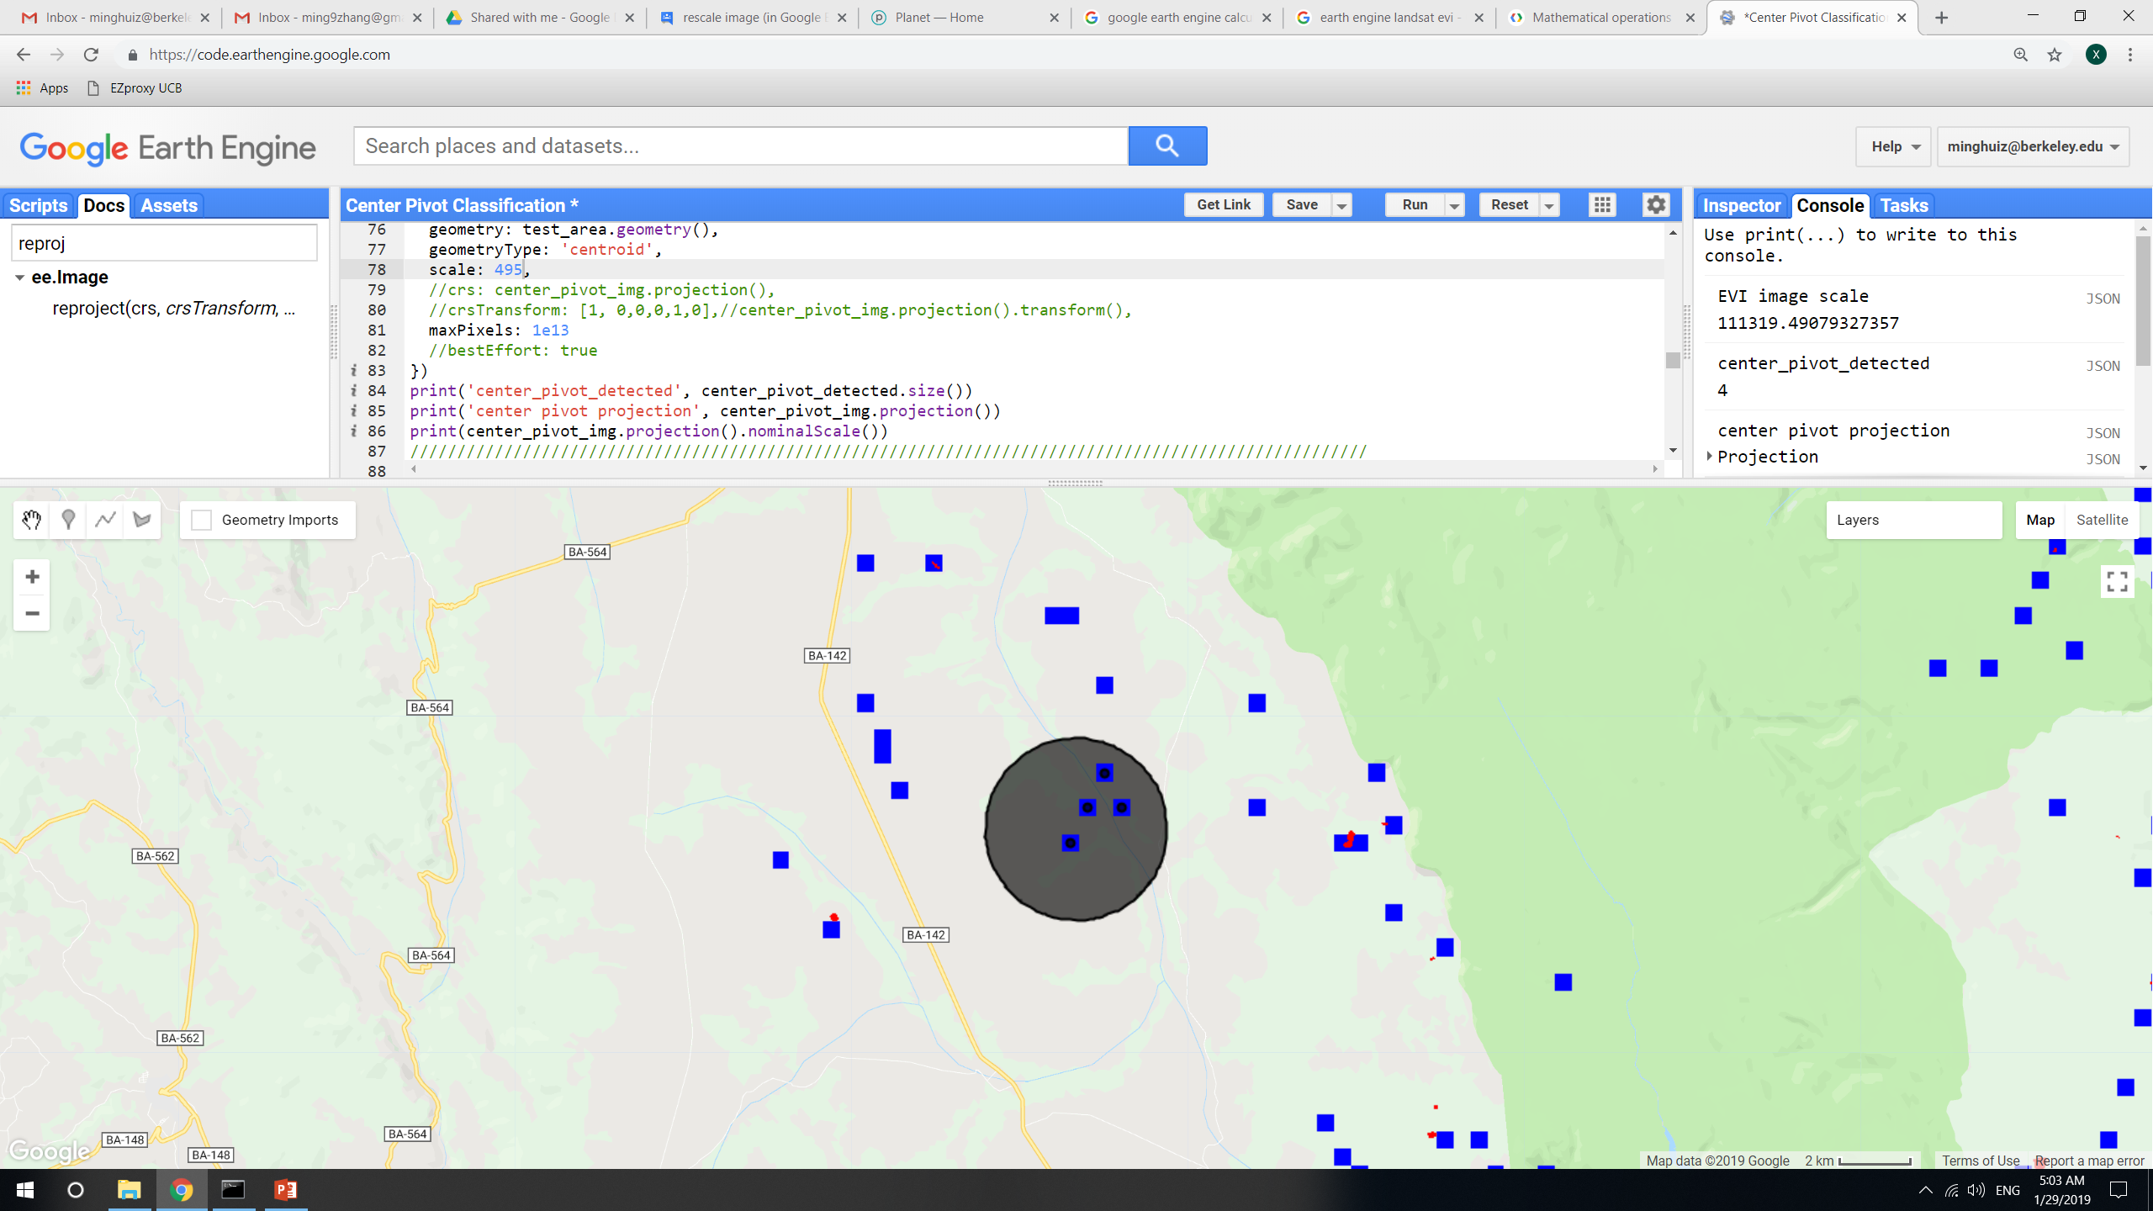
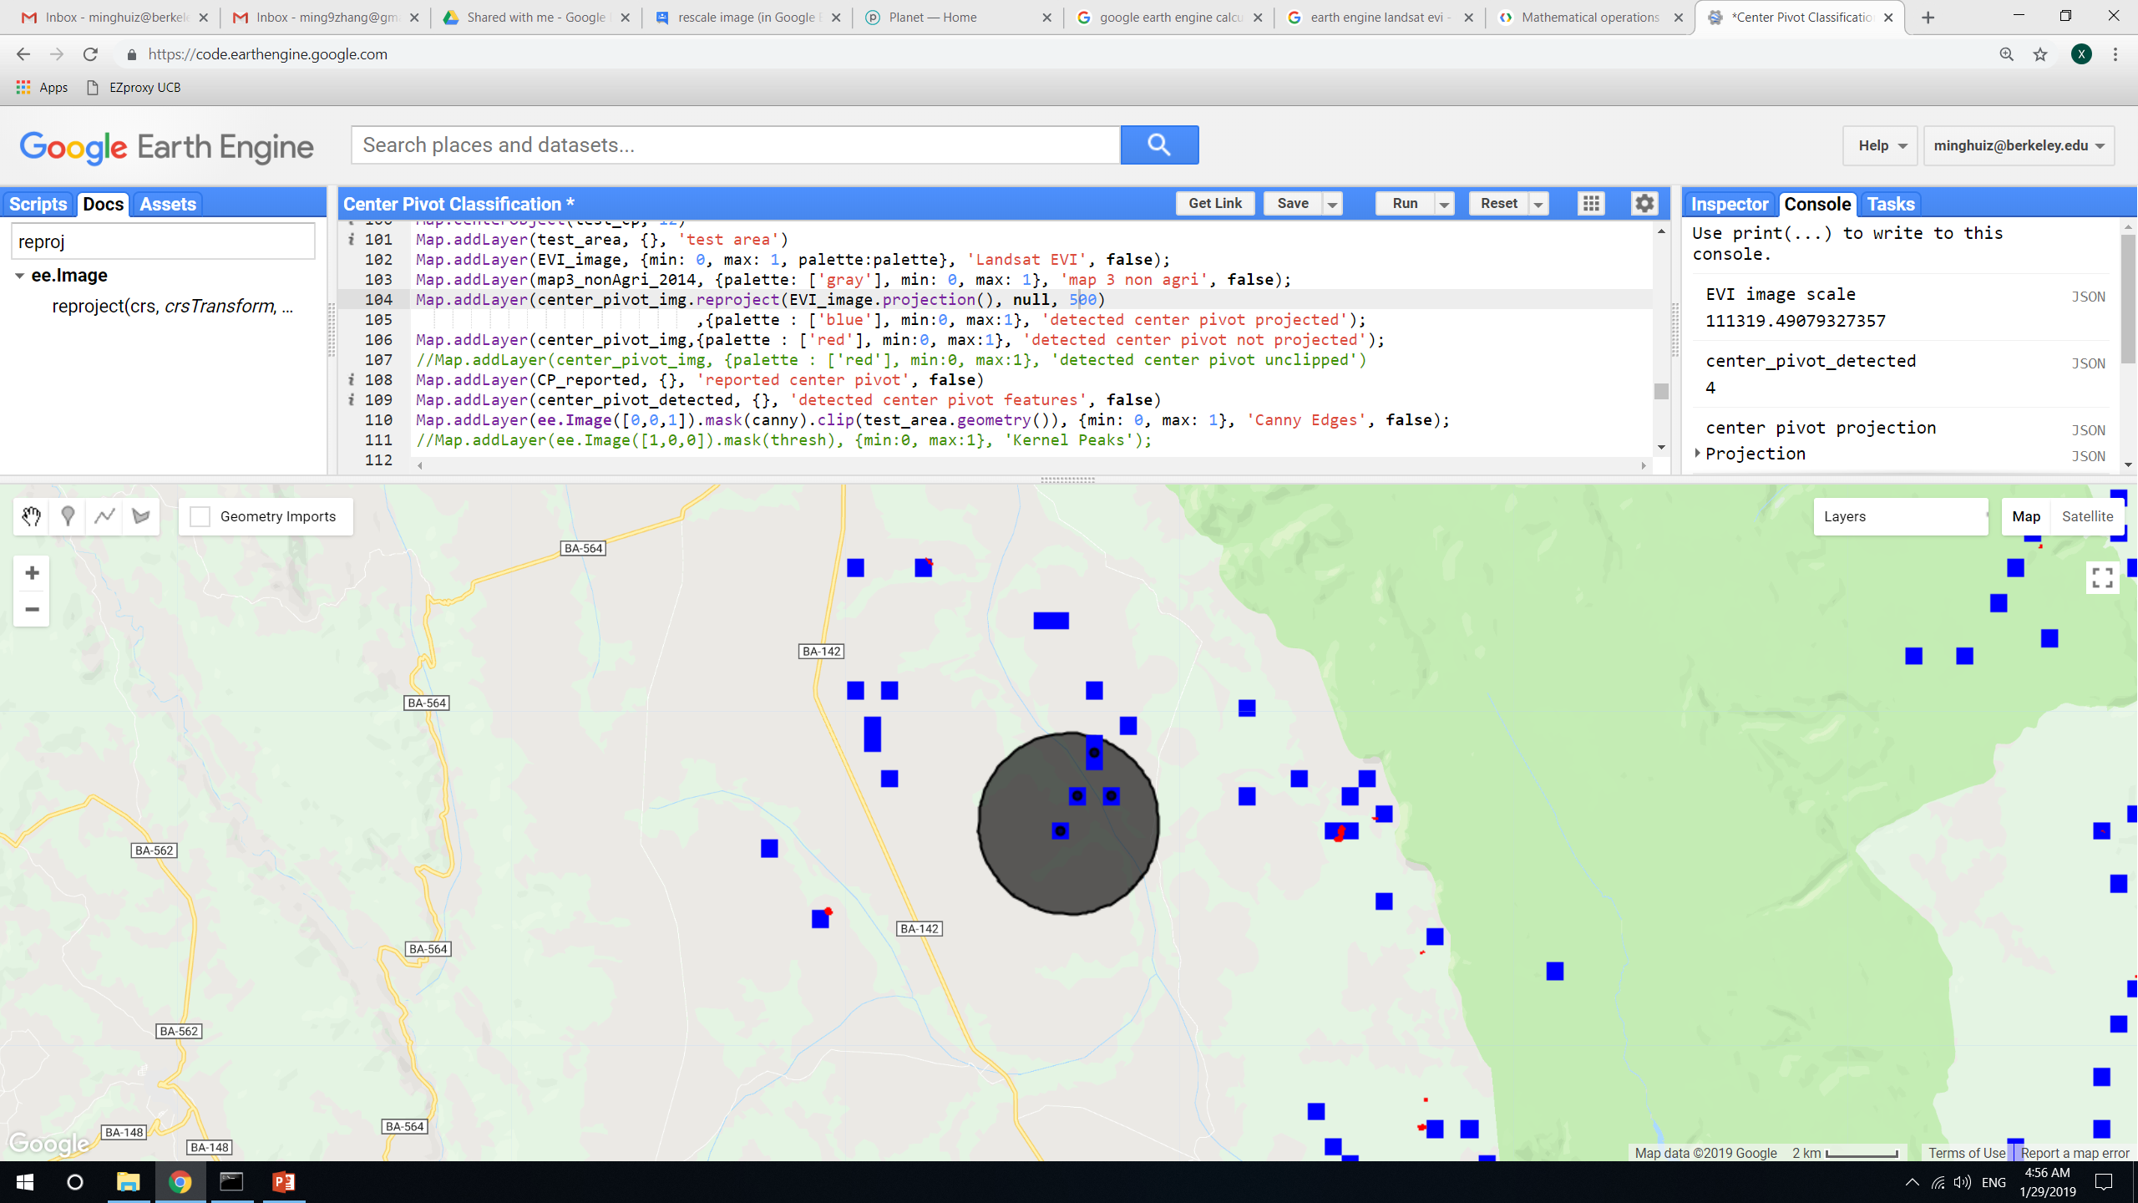
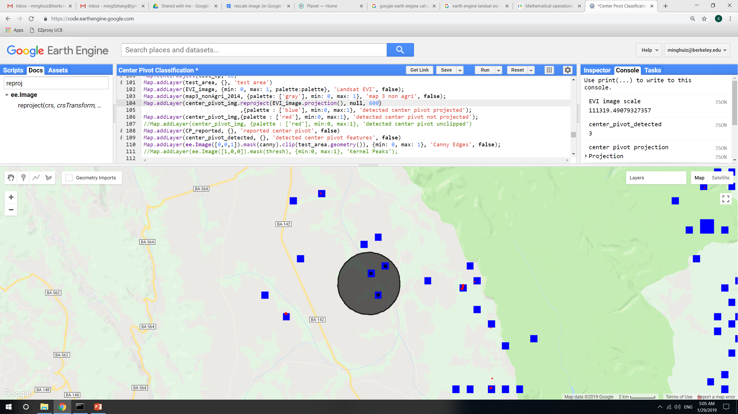
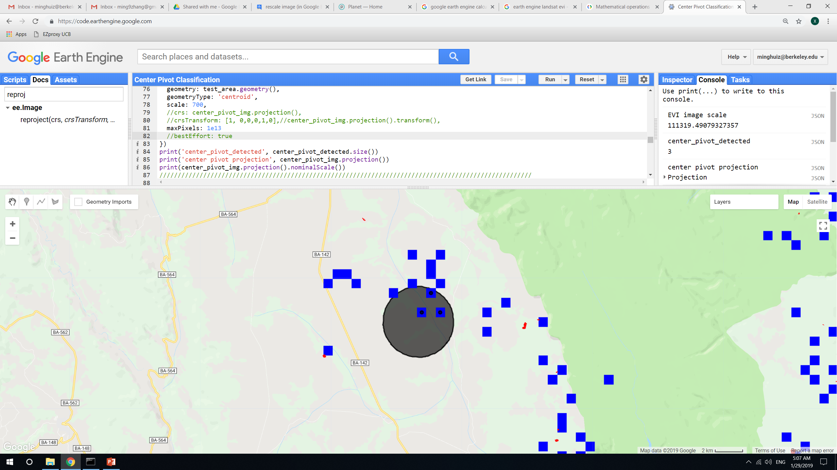
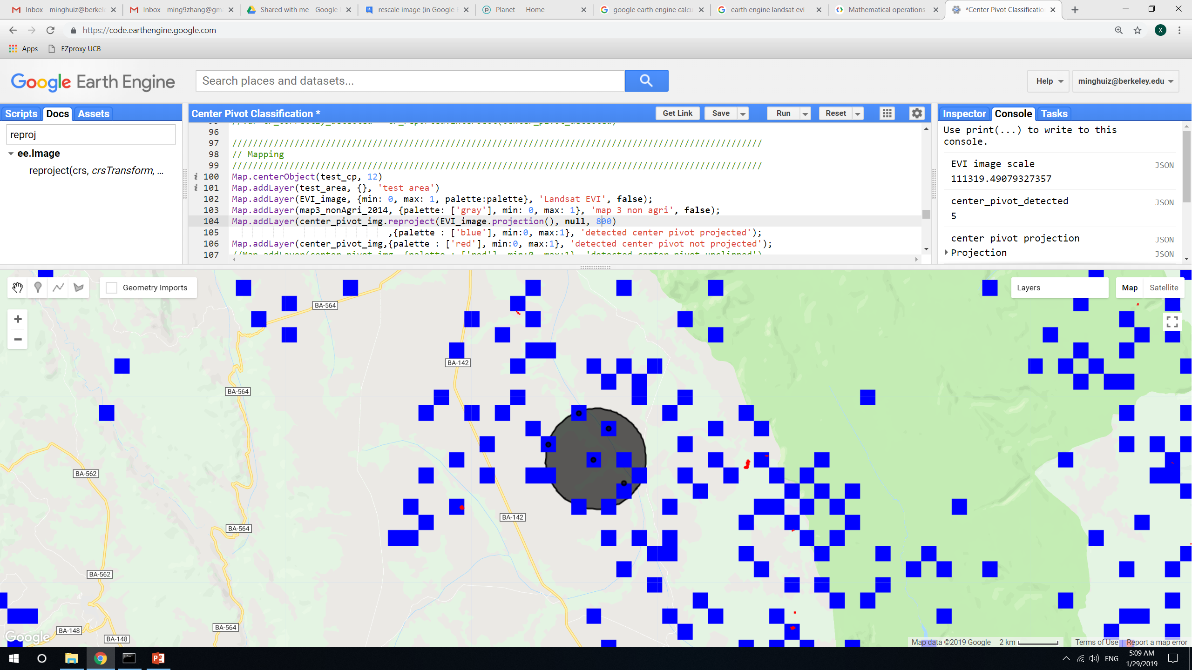
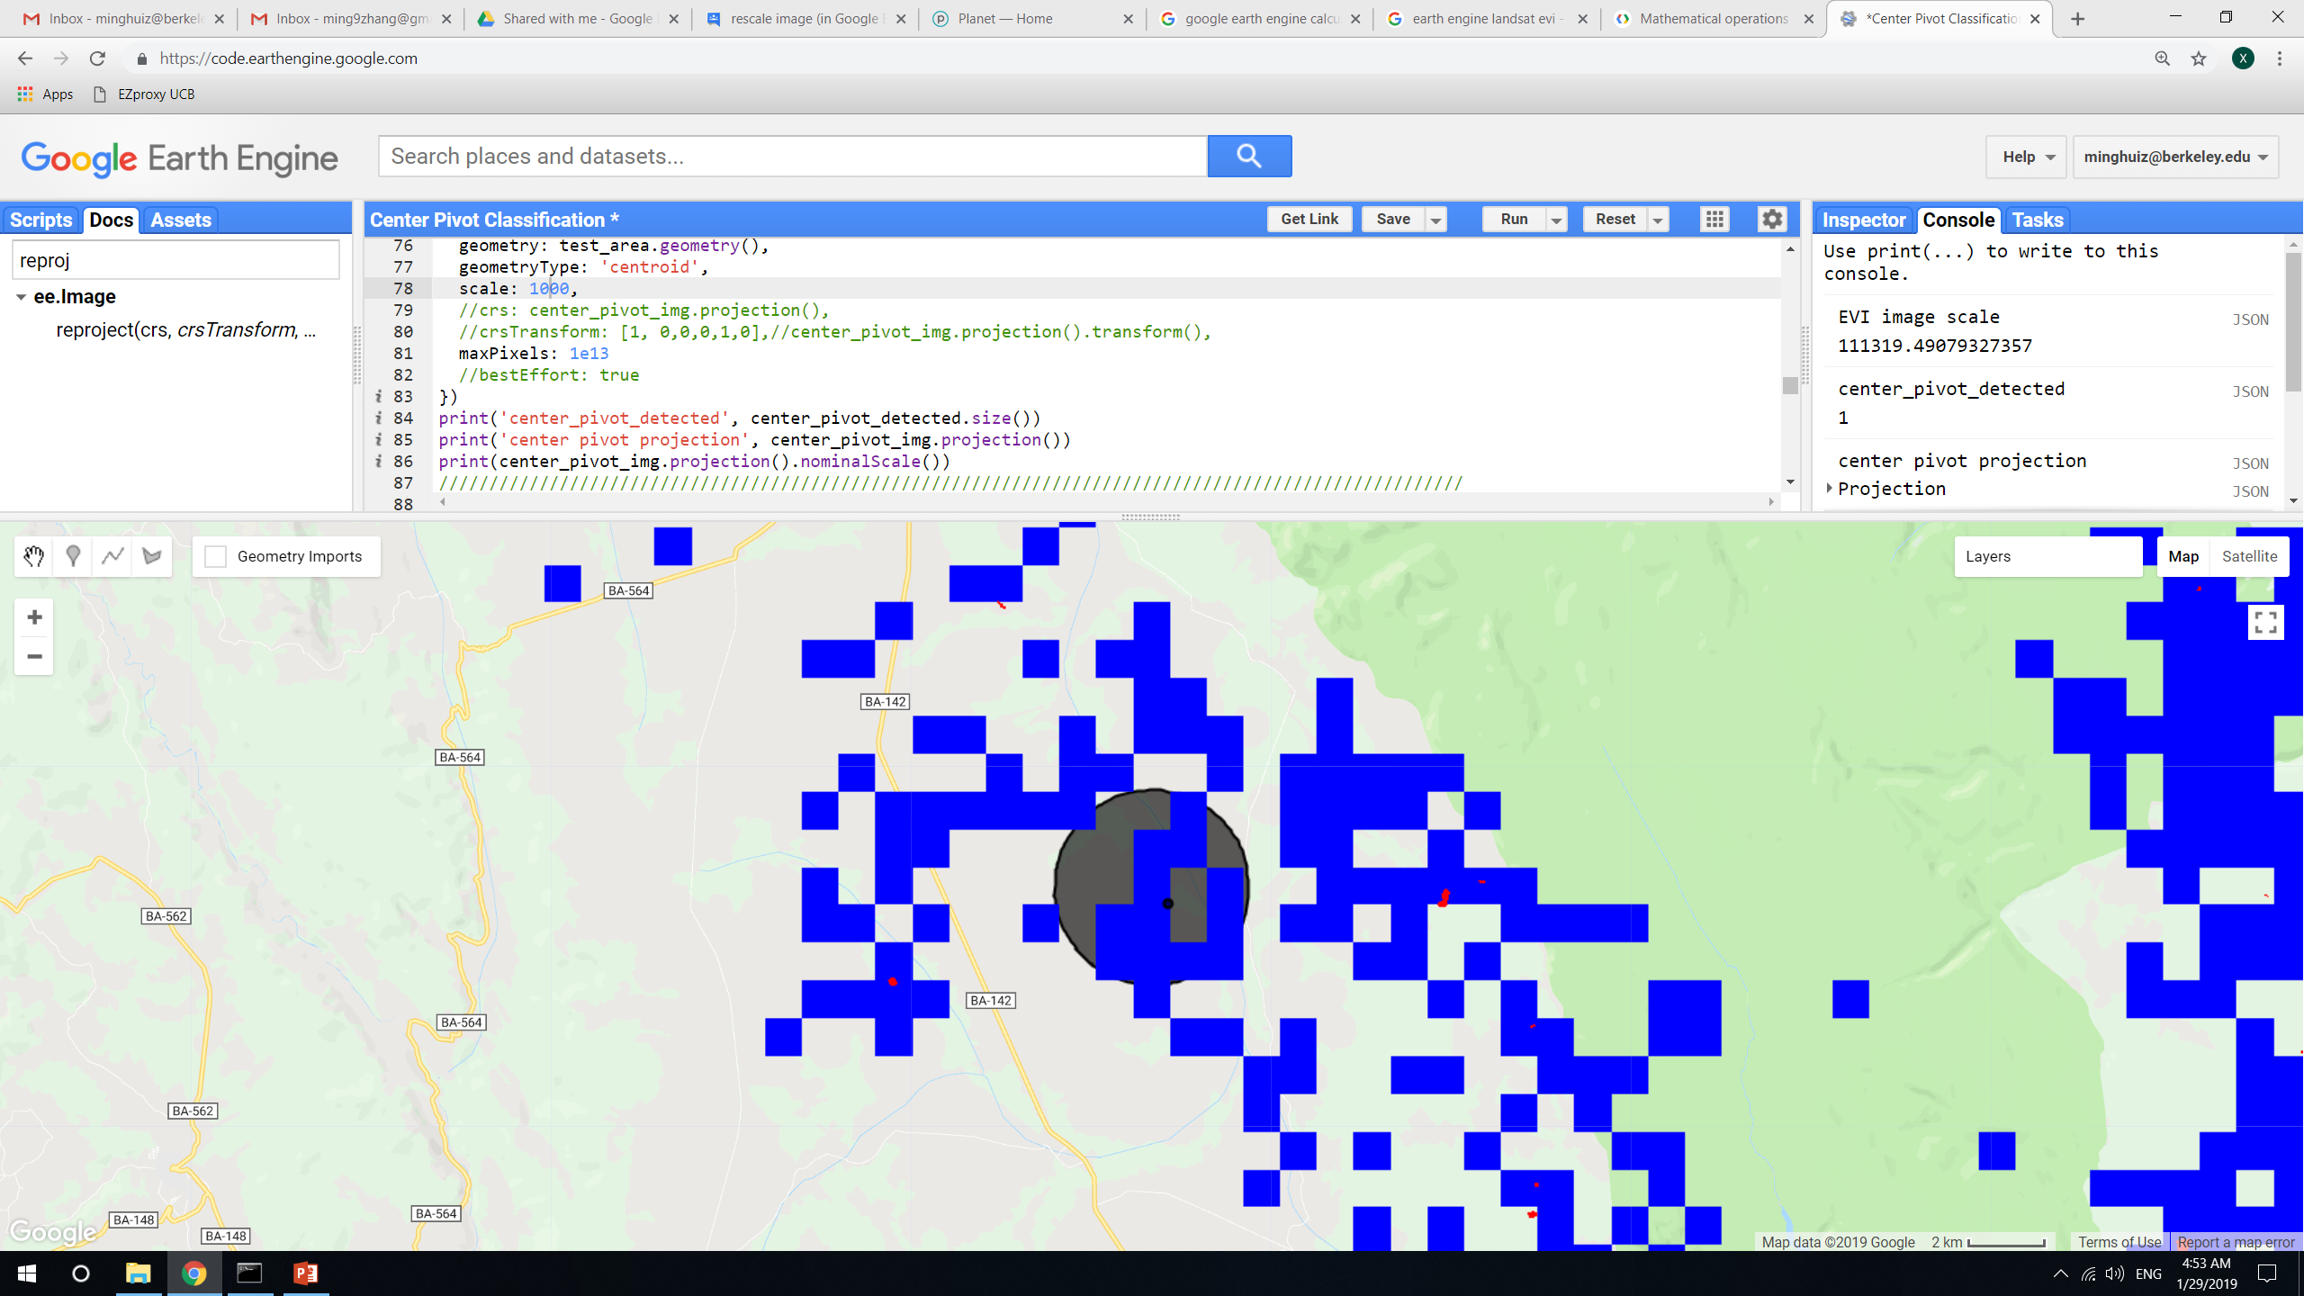
reduceToVectors() and scaling notes
reduceToVectors() and reprojection() scale = 300m
Center pivot detected in test area: 0
reduceToVectors() and reprojection() scale = 400m, 450m
Center pivot detected in test area: 1
reduceToVectors() and reprojection() scale = 480m, 490m
Center pivot detected in test area: 0
reduceToVectors() and reprojection() scale = 495m
Center pivot detected in test area: 4
reduceToVectors() and reprojection() scale = 500m
Center pivot detected in test area: 4
reduceToVectors() and reprojection() scale = 600m
Center pivot detected in test area: 3
reduceToVectors() and reprojection() scale = 1000m
Center pivot detected in test area: 1
reduceToVectors() and reprojection() scale = 700m
Center pivot detected in test area: 3
reduceToVectors() and reprojection() scale = 800m
Center pivot detected in test area: 5
In GEE: LandCover/Center Pivot Classification

Slide 13
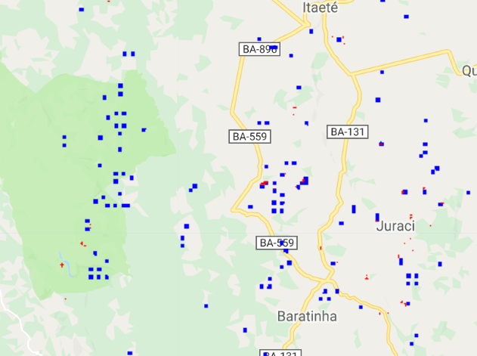
reduceToVectors() and scaling notes
Because EVI composite from Landsat is at 110m/pixel scale, try using a single landsat image at 30m/pixel scale and running center pivot detection
Unfortunately, the same problem: there are blue (reprojected) pixels where red (un reprojected) pixels don’t show up, and vice versa
In GEE: LandCover/Center Pivot Classification v2

Slide 14
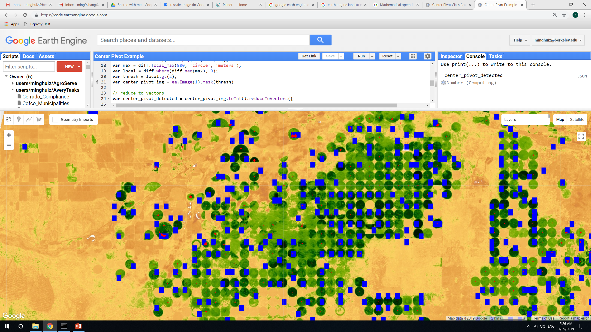
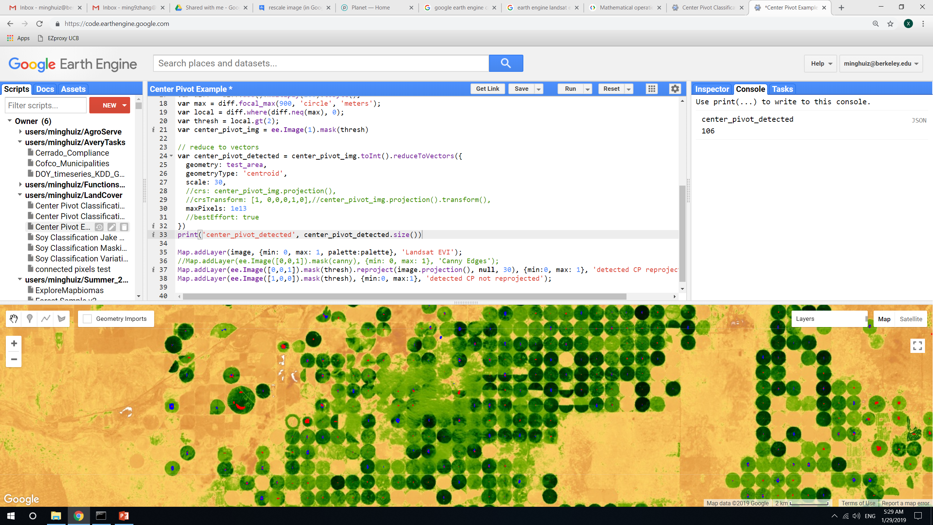
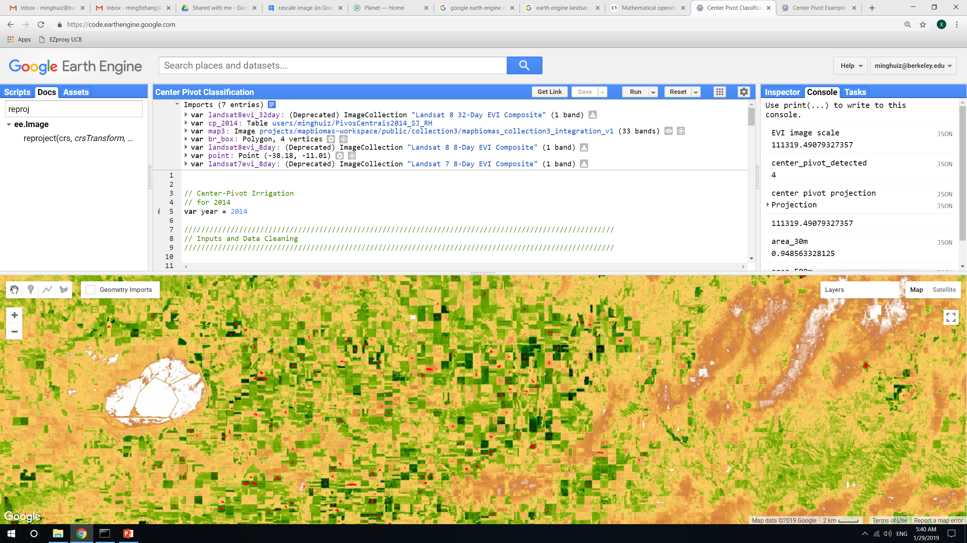
reduceToVectors() and scaling notes: for Kansas
Reprojecting to 500m scale misses a lot of detected center pivots.
Unlike over Brazil, doing reduceToVectors() at 30m scale still produces results and the blue doesn’t seem to be completely offset after reprojection()
reduceToVectors() and reprojection() scale = 500m
Center pivot detected in test area: 112
reduceToVectors() and reprojection() scale = 500m
Center pivot detected in test area: 102
Even in Kansas, heterogeneous fields are detected
In GEE: LandCover/Center Pivot Example

Slide 15
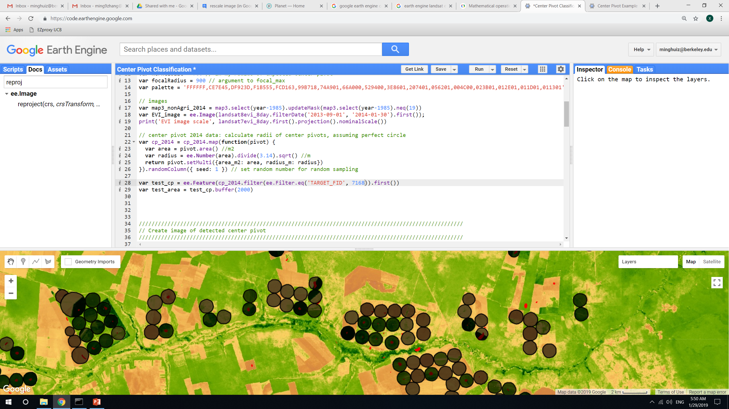
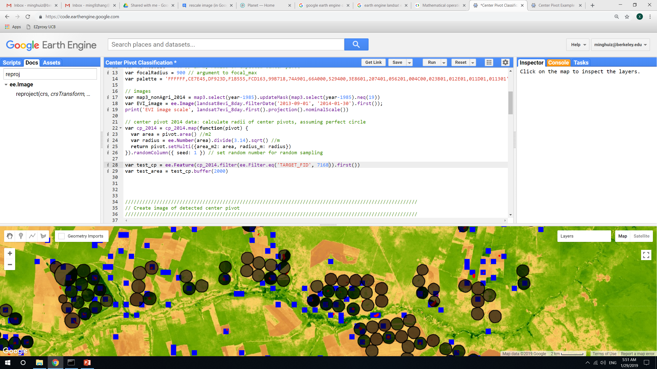
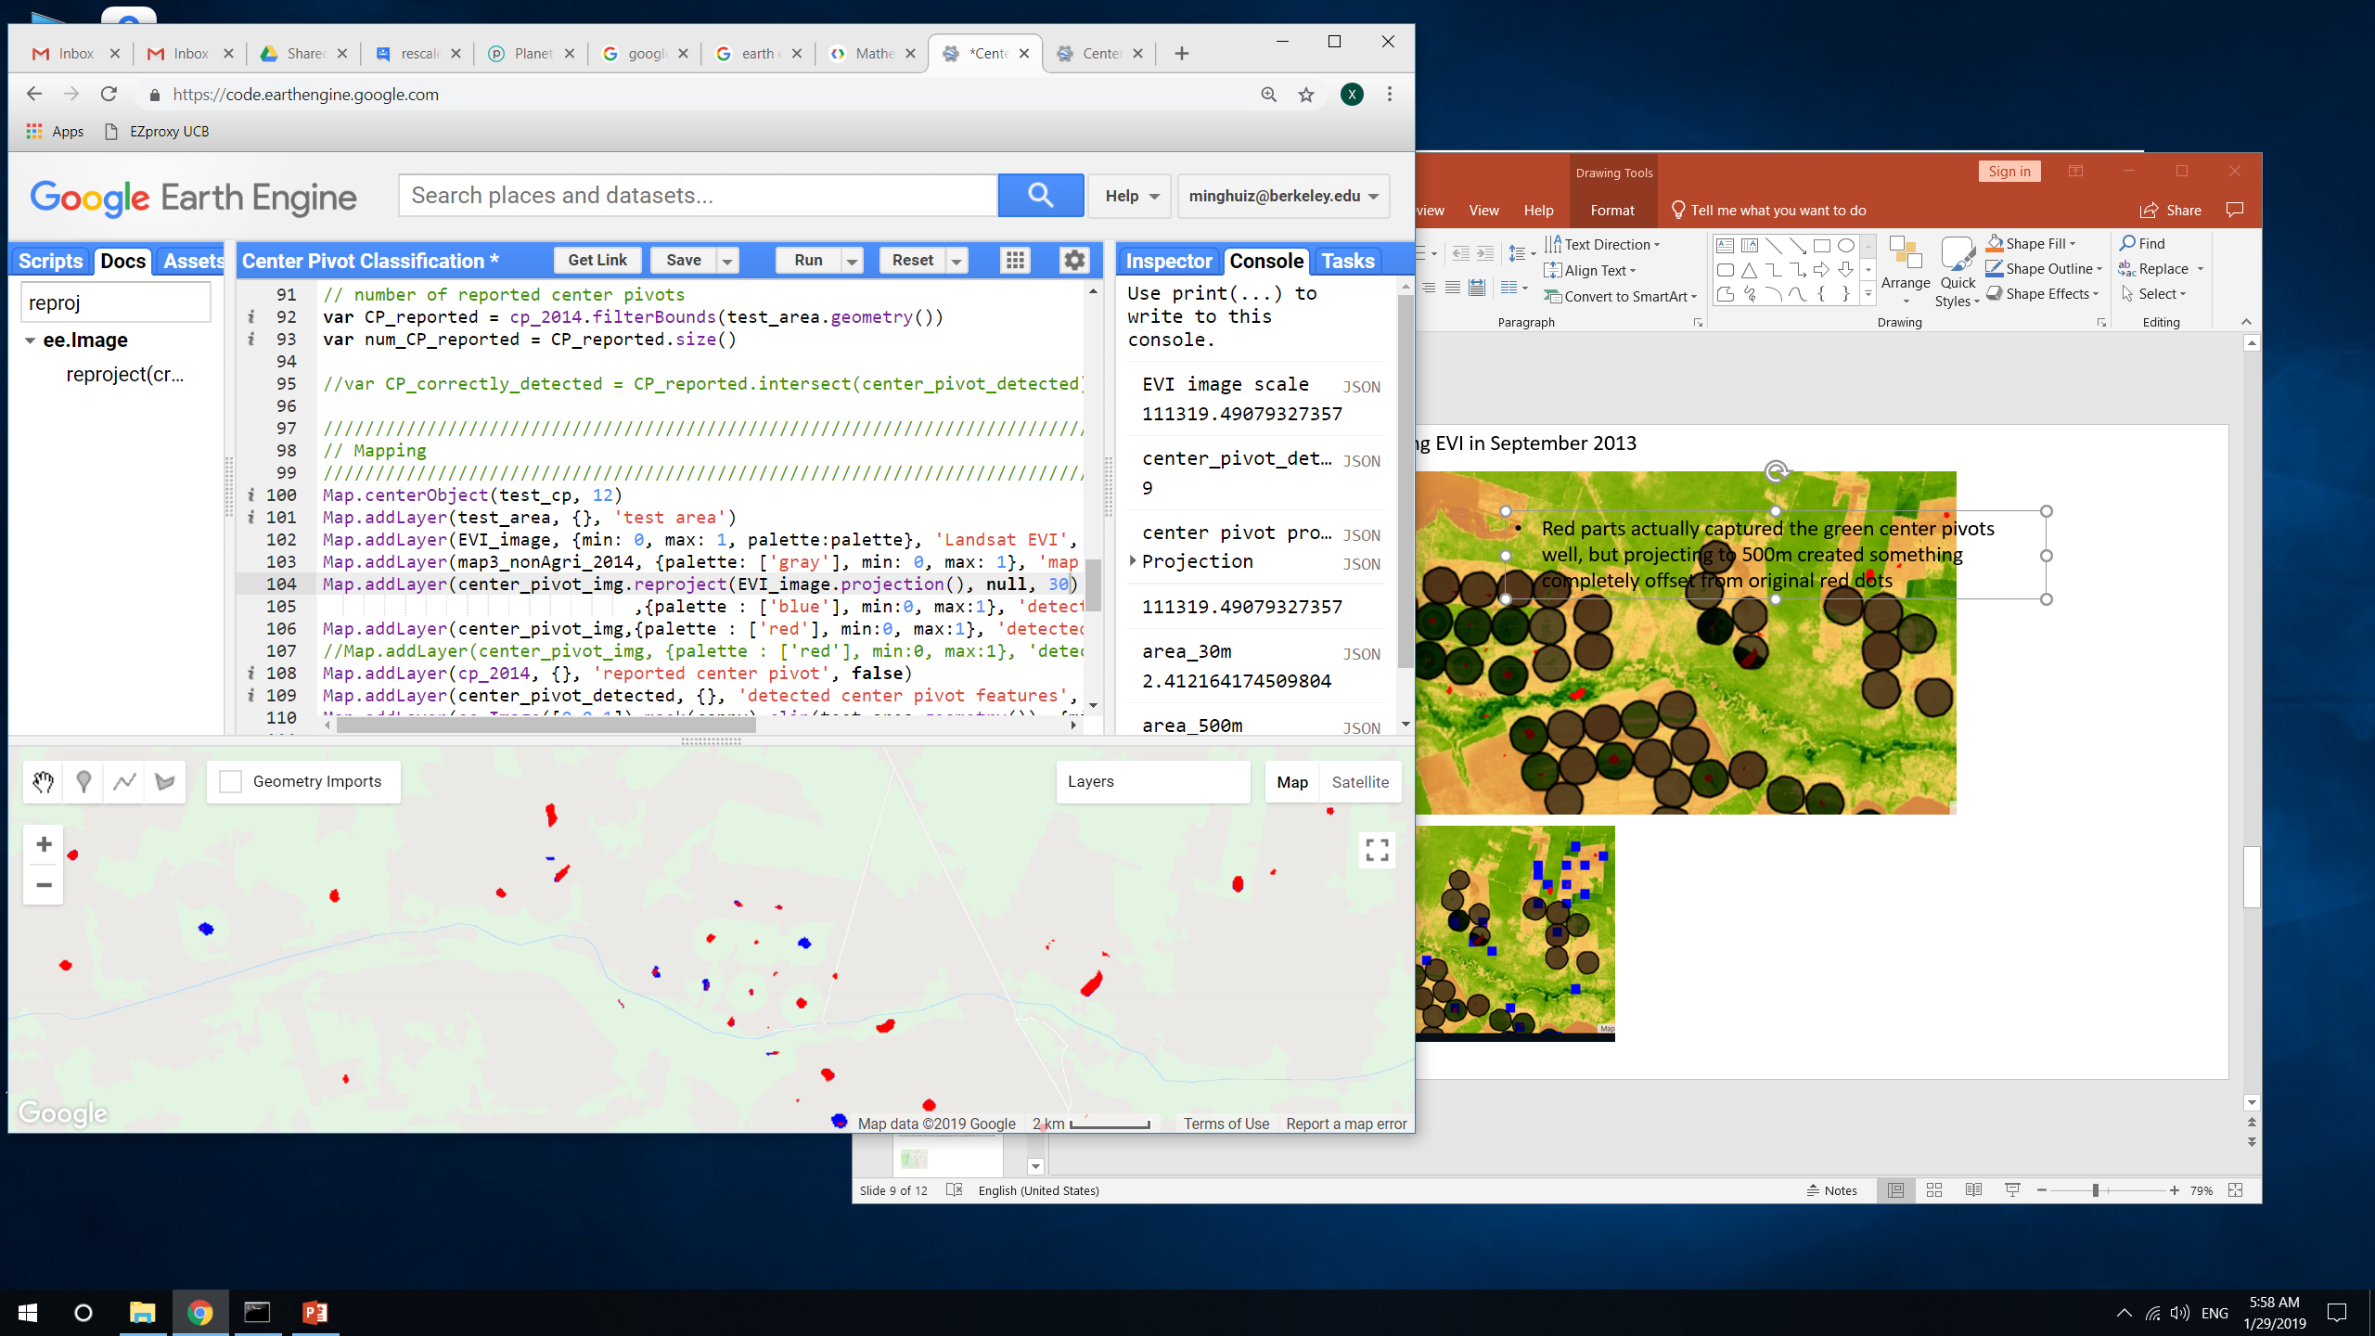
Brazil center pivot edge detection: using EVI in September 2013
Red parts actually captured the green center pivots well, but projecting to 500m created something completely offset from original red dots
When reprojecting and doing reduceToVectors at 30m, unlike before, actually got some blue (post reprojection) dots and got nine actual detected CP features – takeaway: the reduceToVectors() should be done at 30m and probably at start or end of growing season
TAKEAWAY: do reduceToVectors() analysis at 30m scale. If the area actually has obvious center pivots, reduceToVectors() and reprojection() will pick them up. Otherwise, doing reduceToVectors() at 30m will give no results, which is good.
Perhaps it ‘looked like’ red dots were showing up at zoomed out level was because neighboring areas ‘contributed’ the red dots.
Reprojected() at 500m
Reprojected() at 30m
In GEE: LandCover/Center Pivot Classification

Slide 16
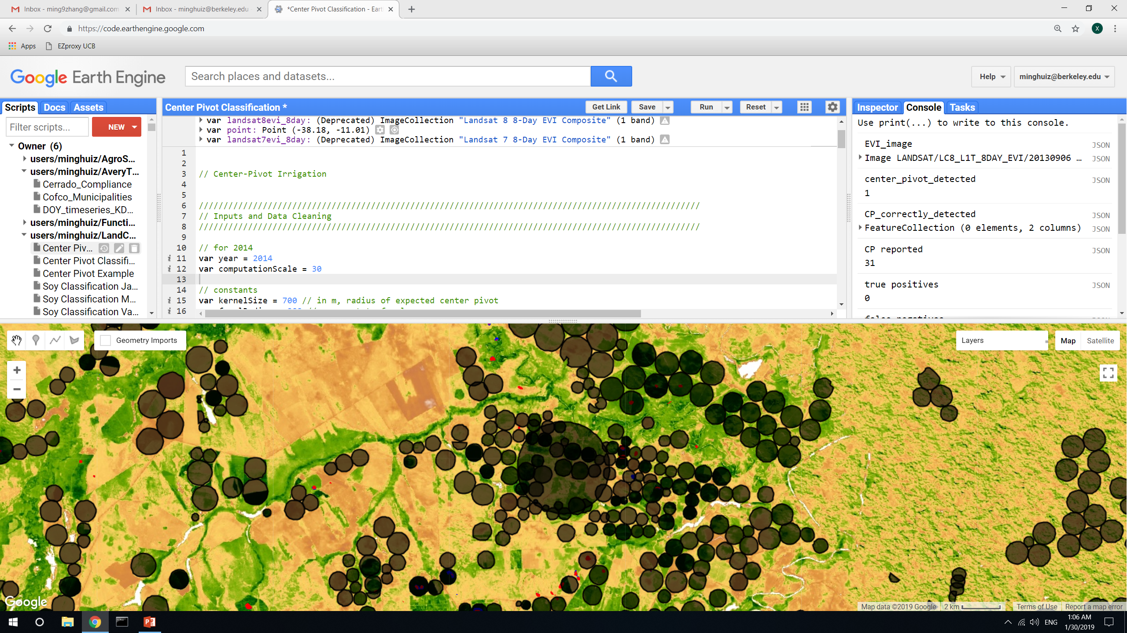
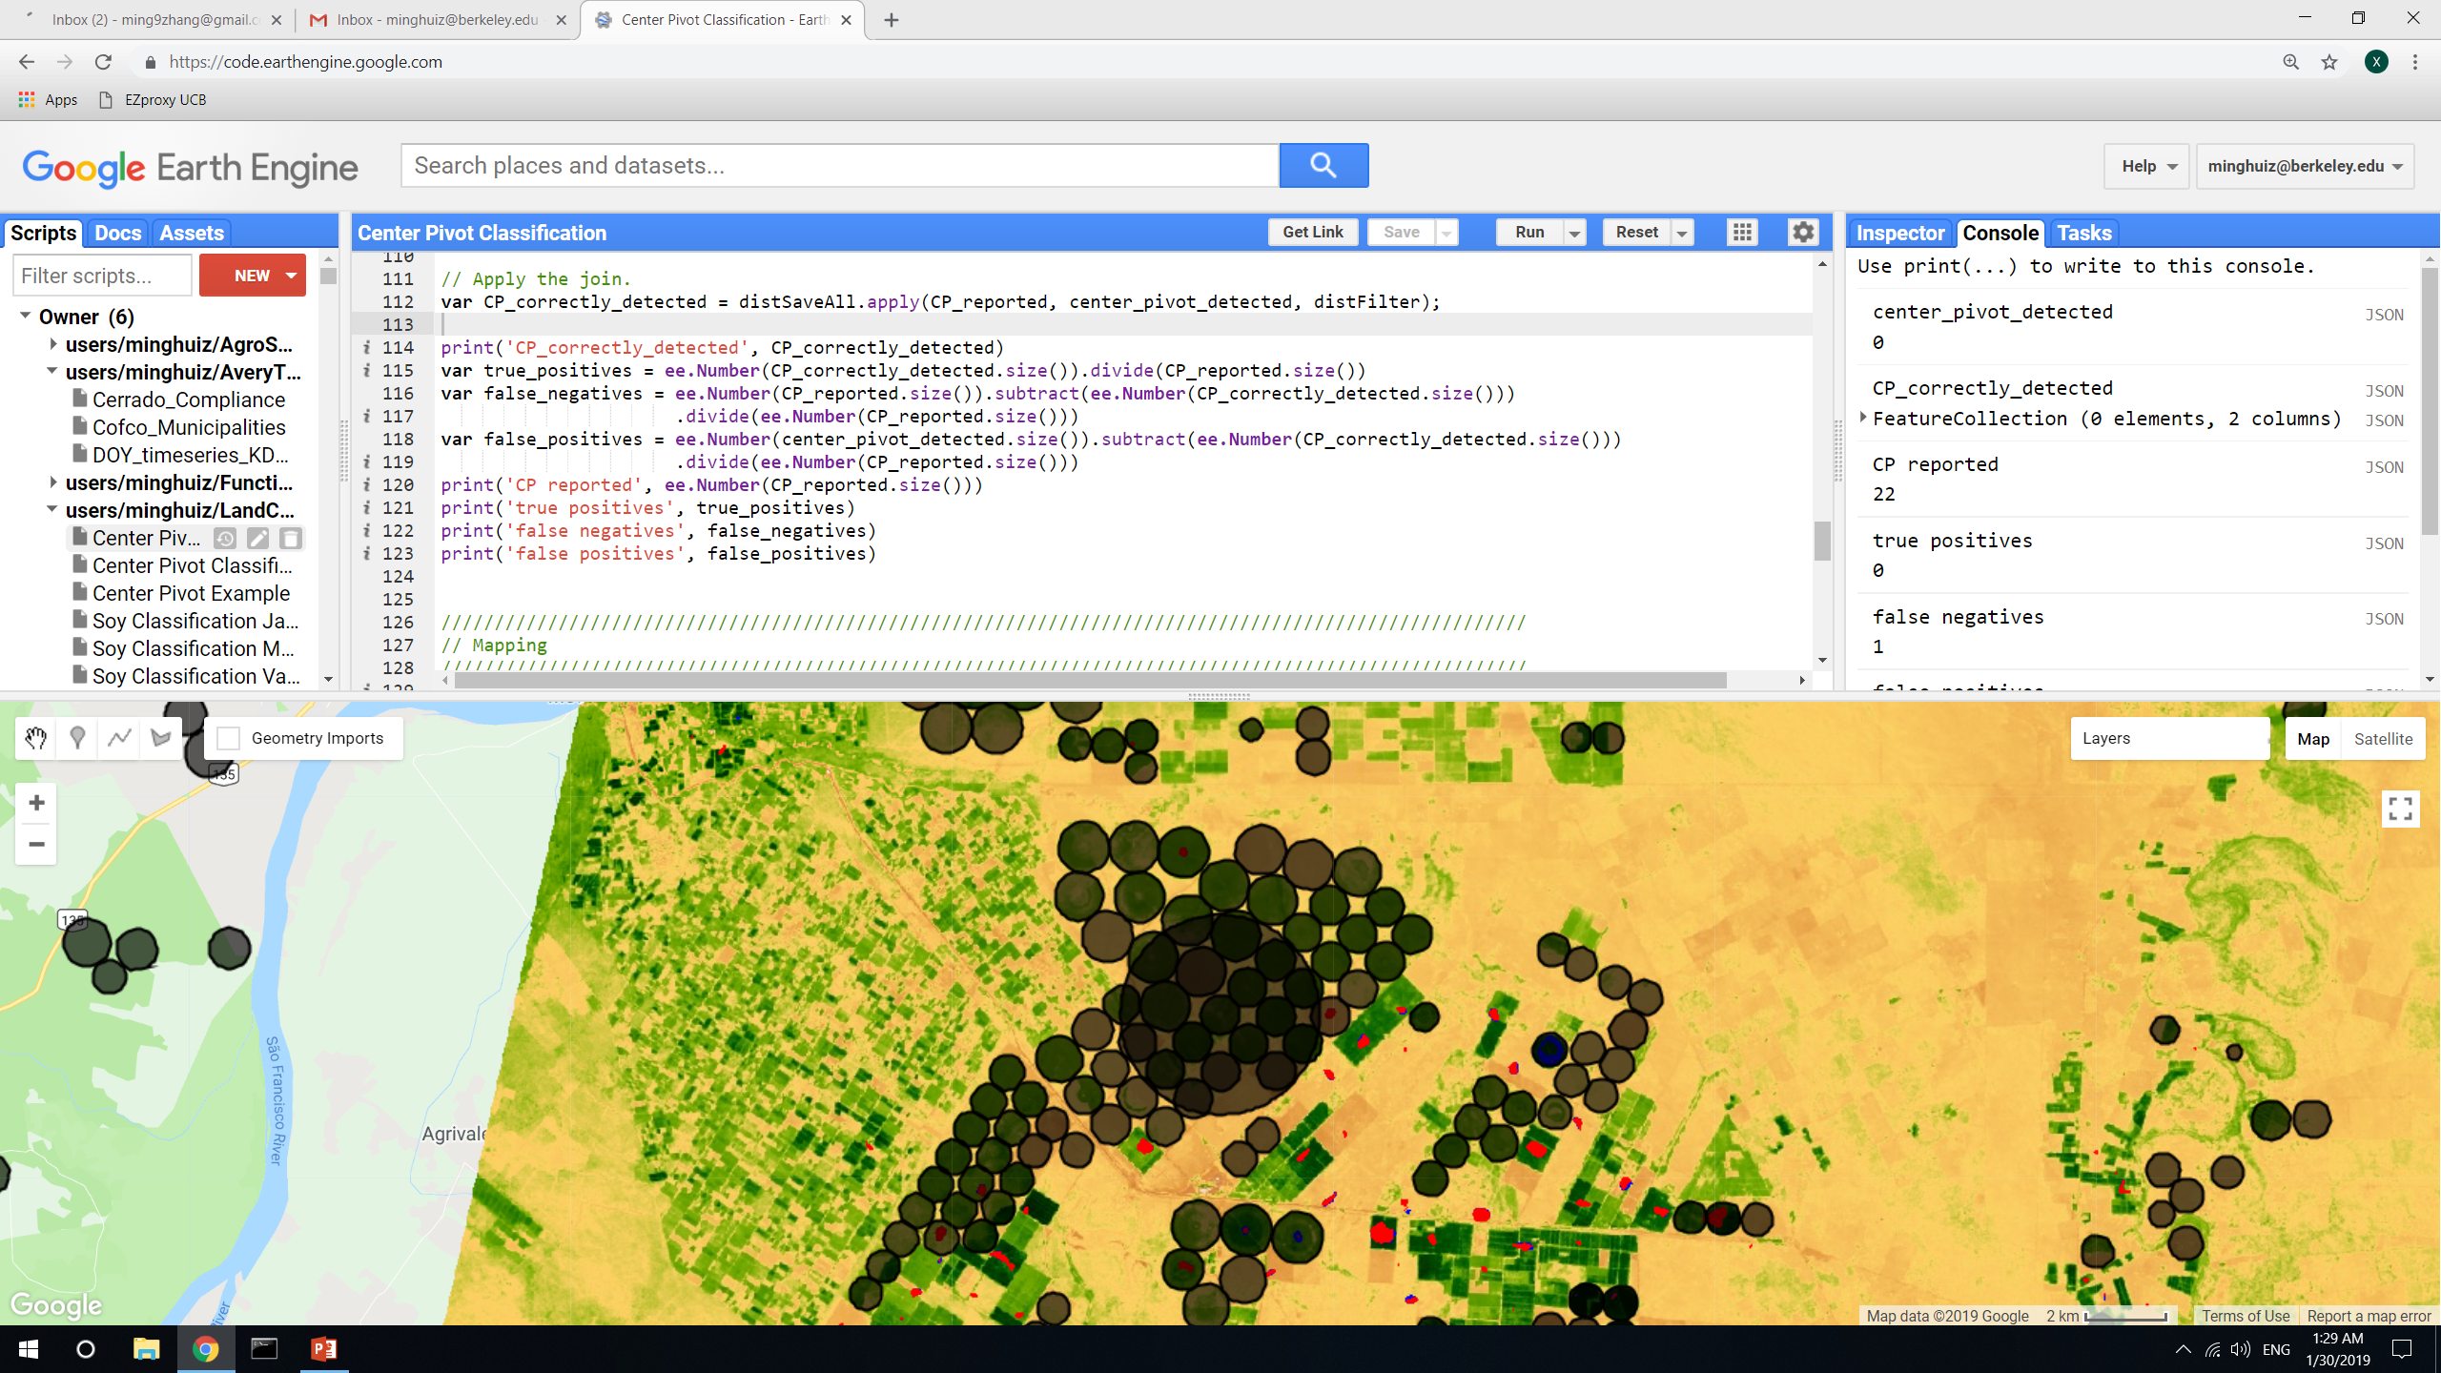
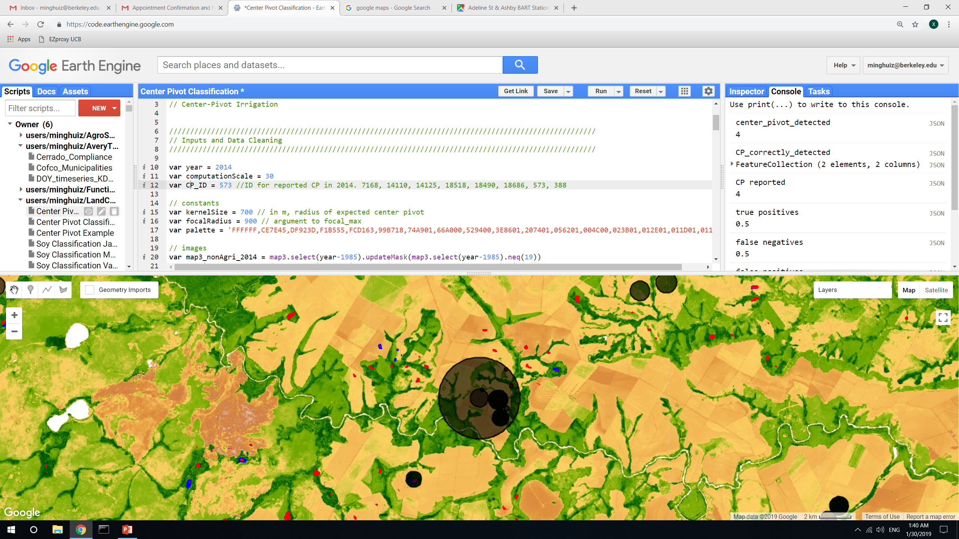
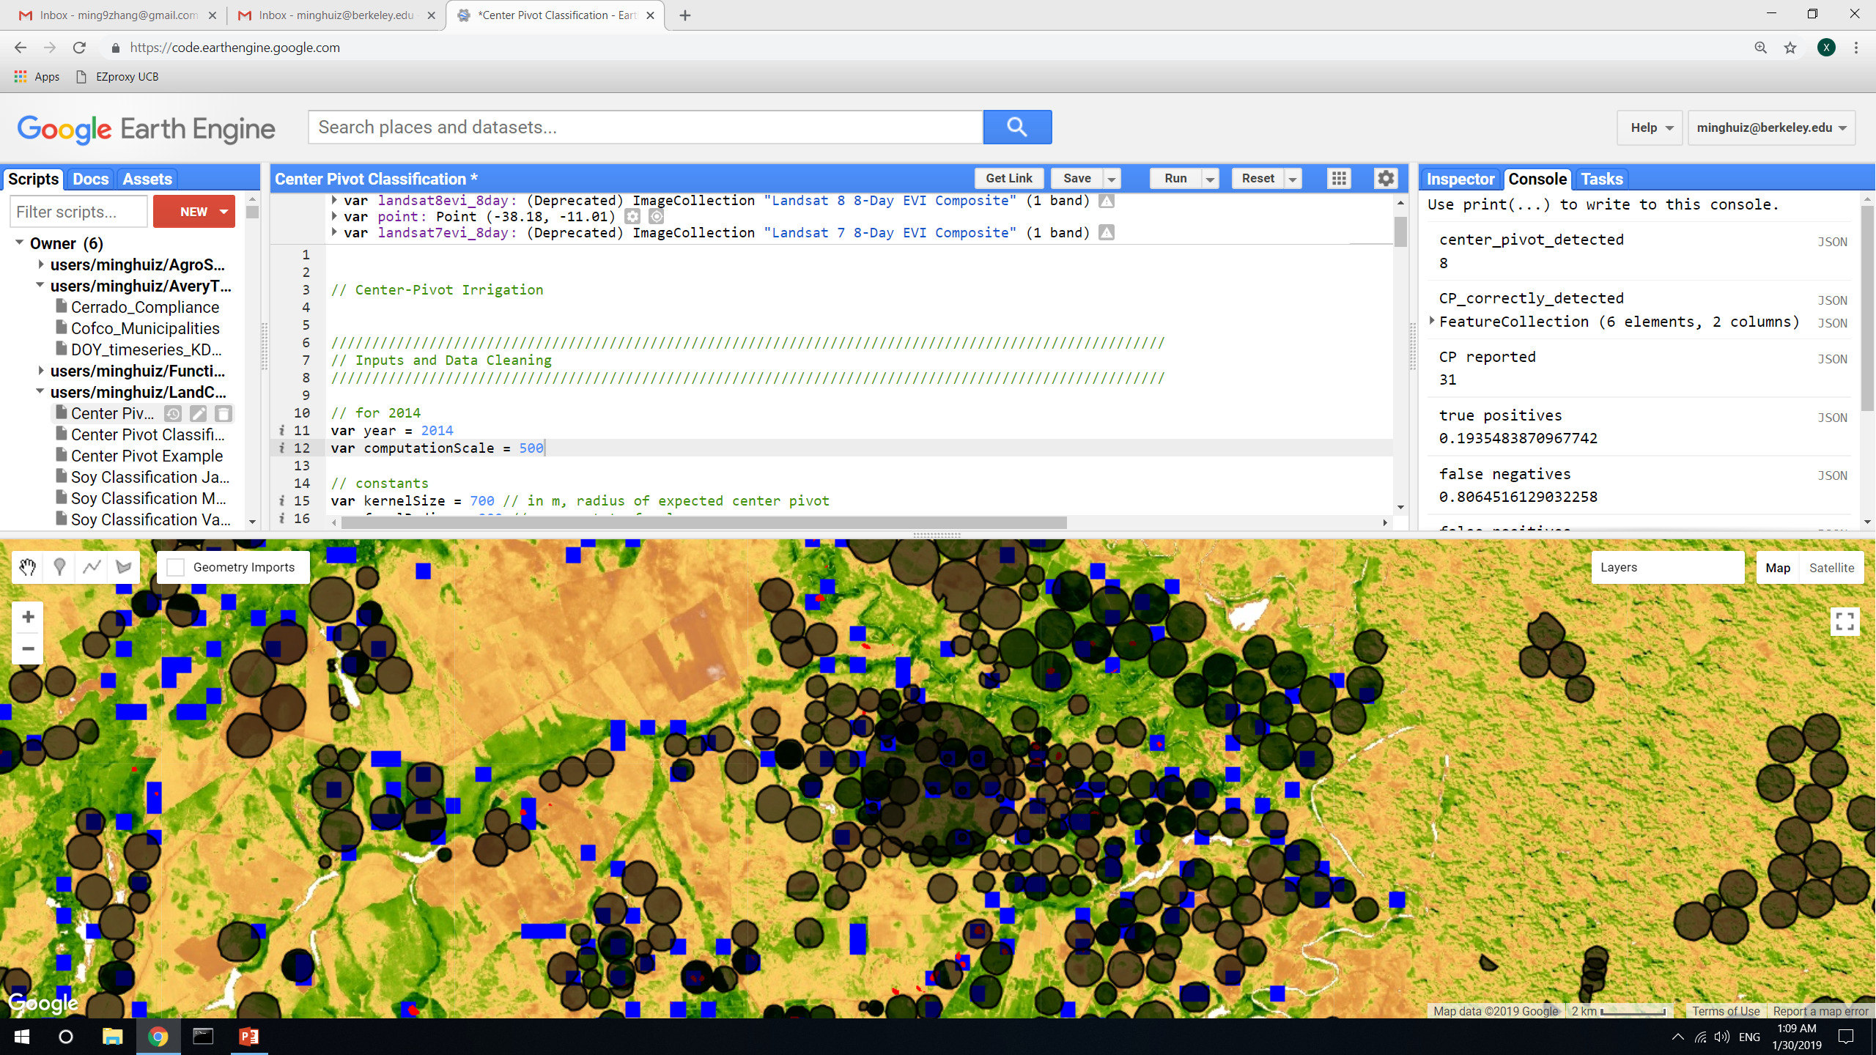
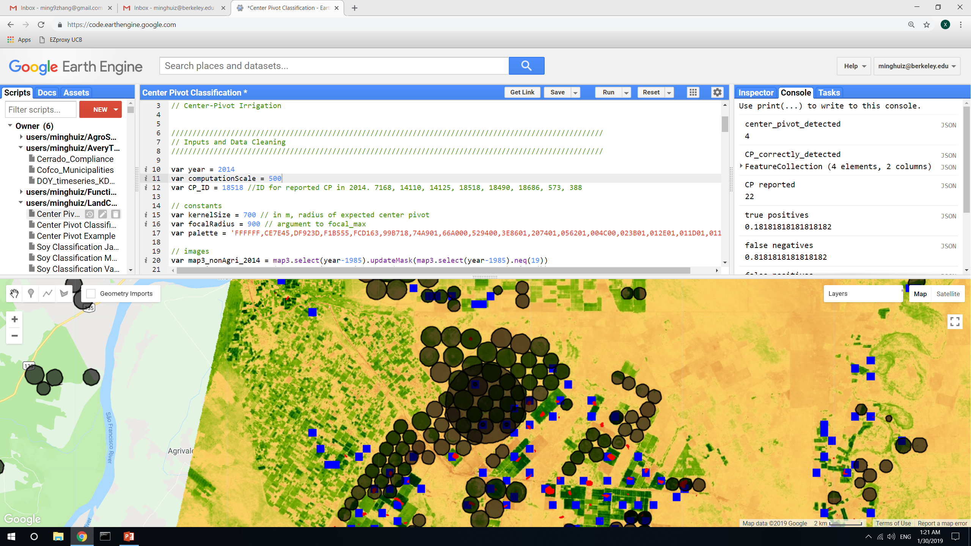
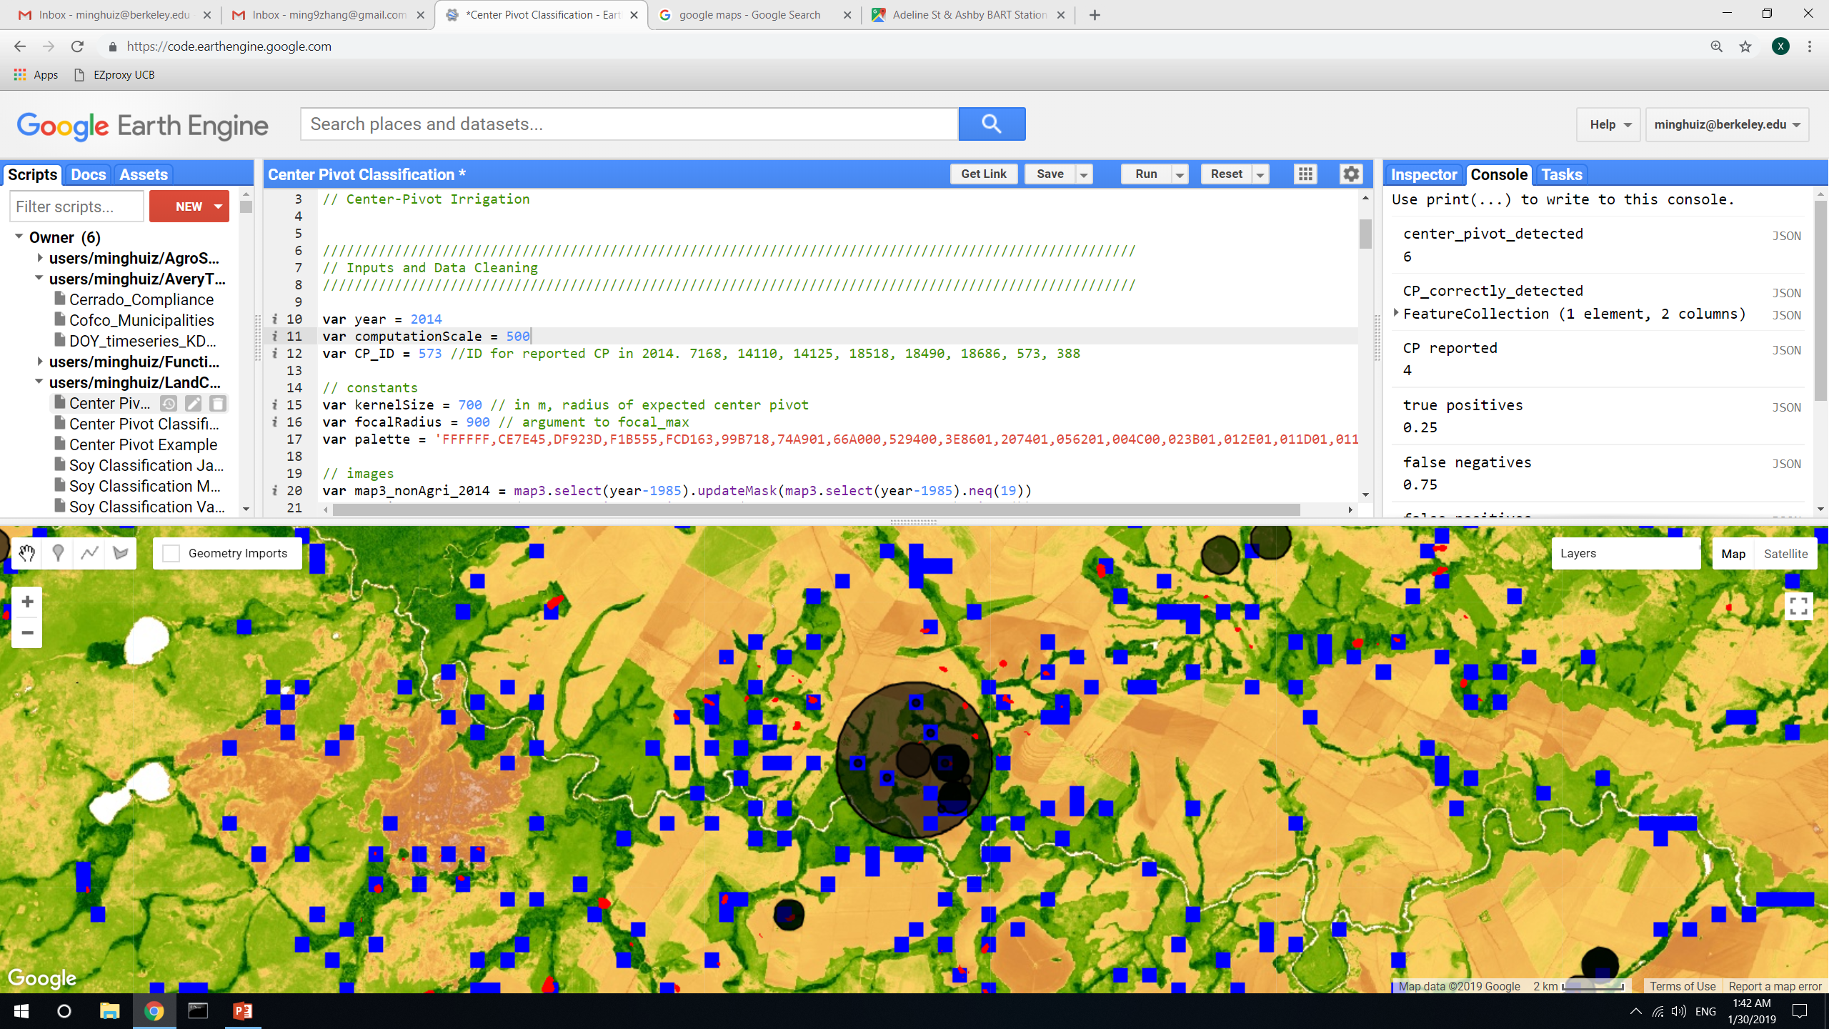
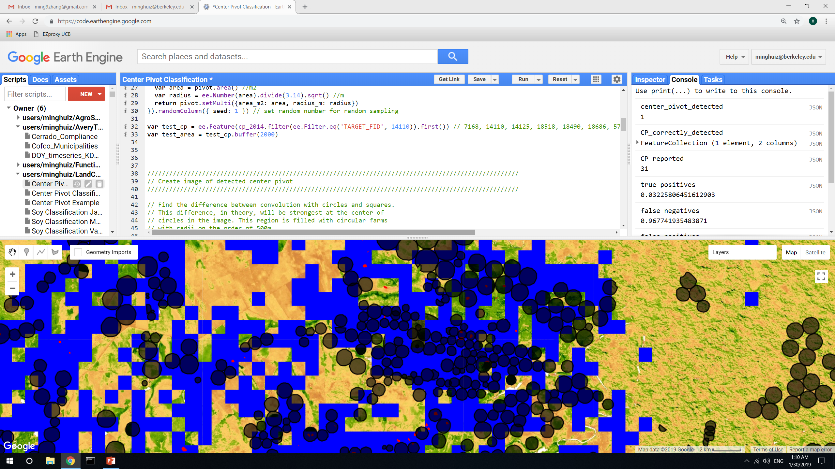
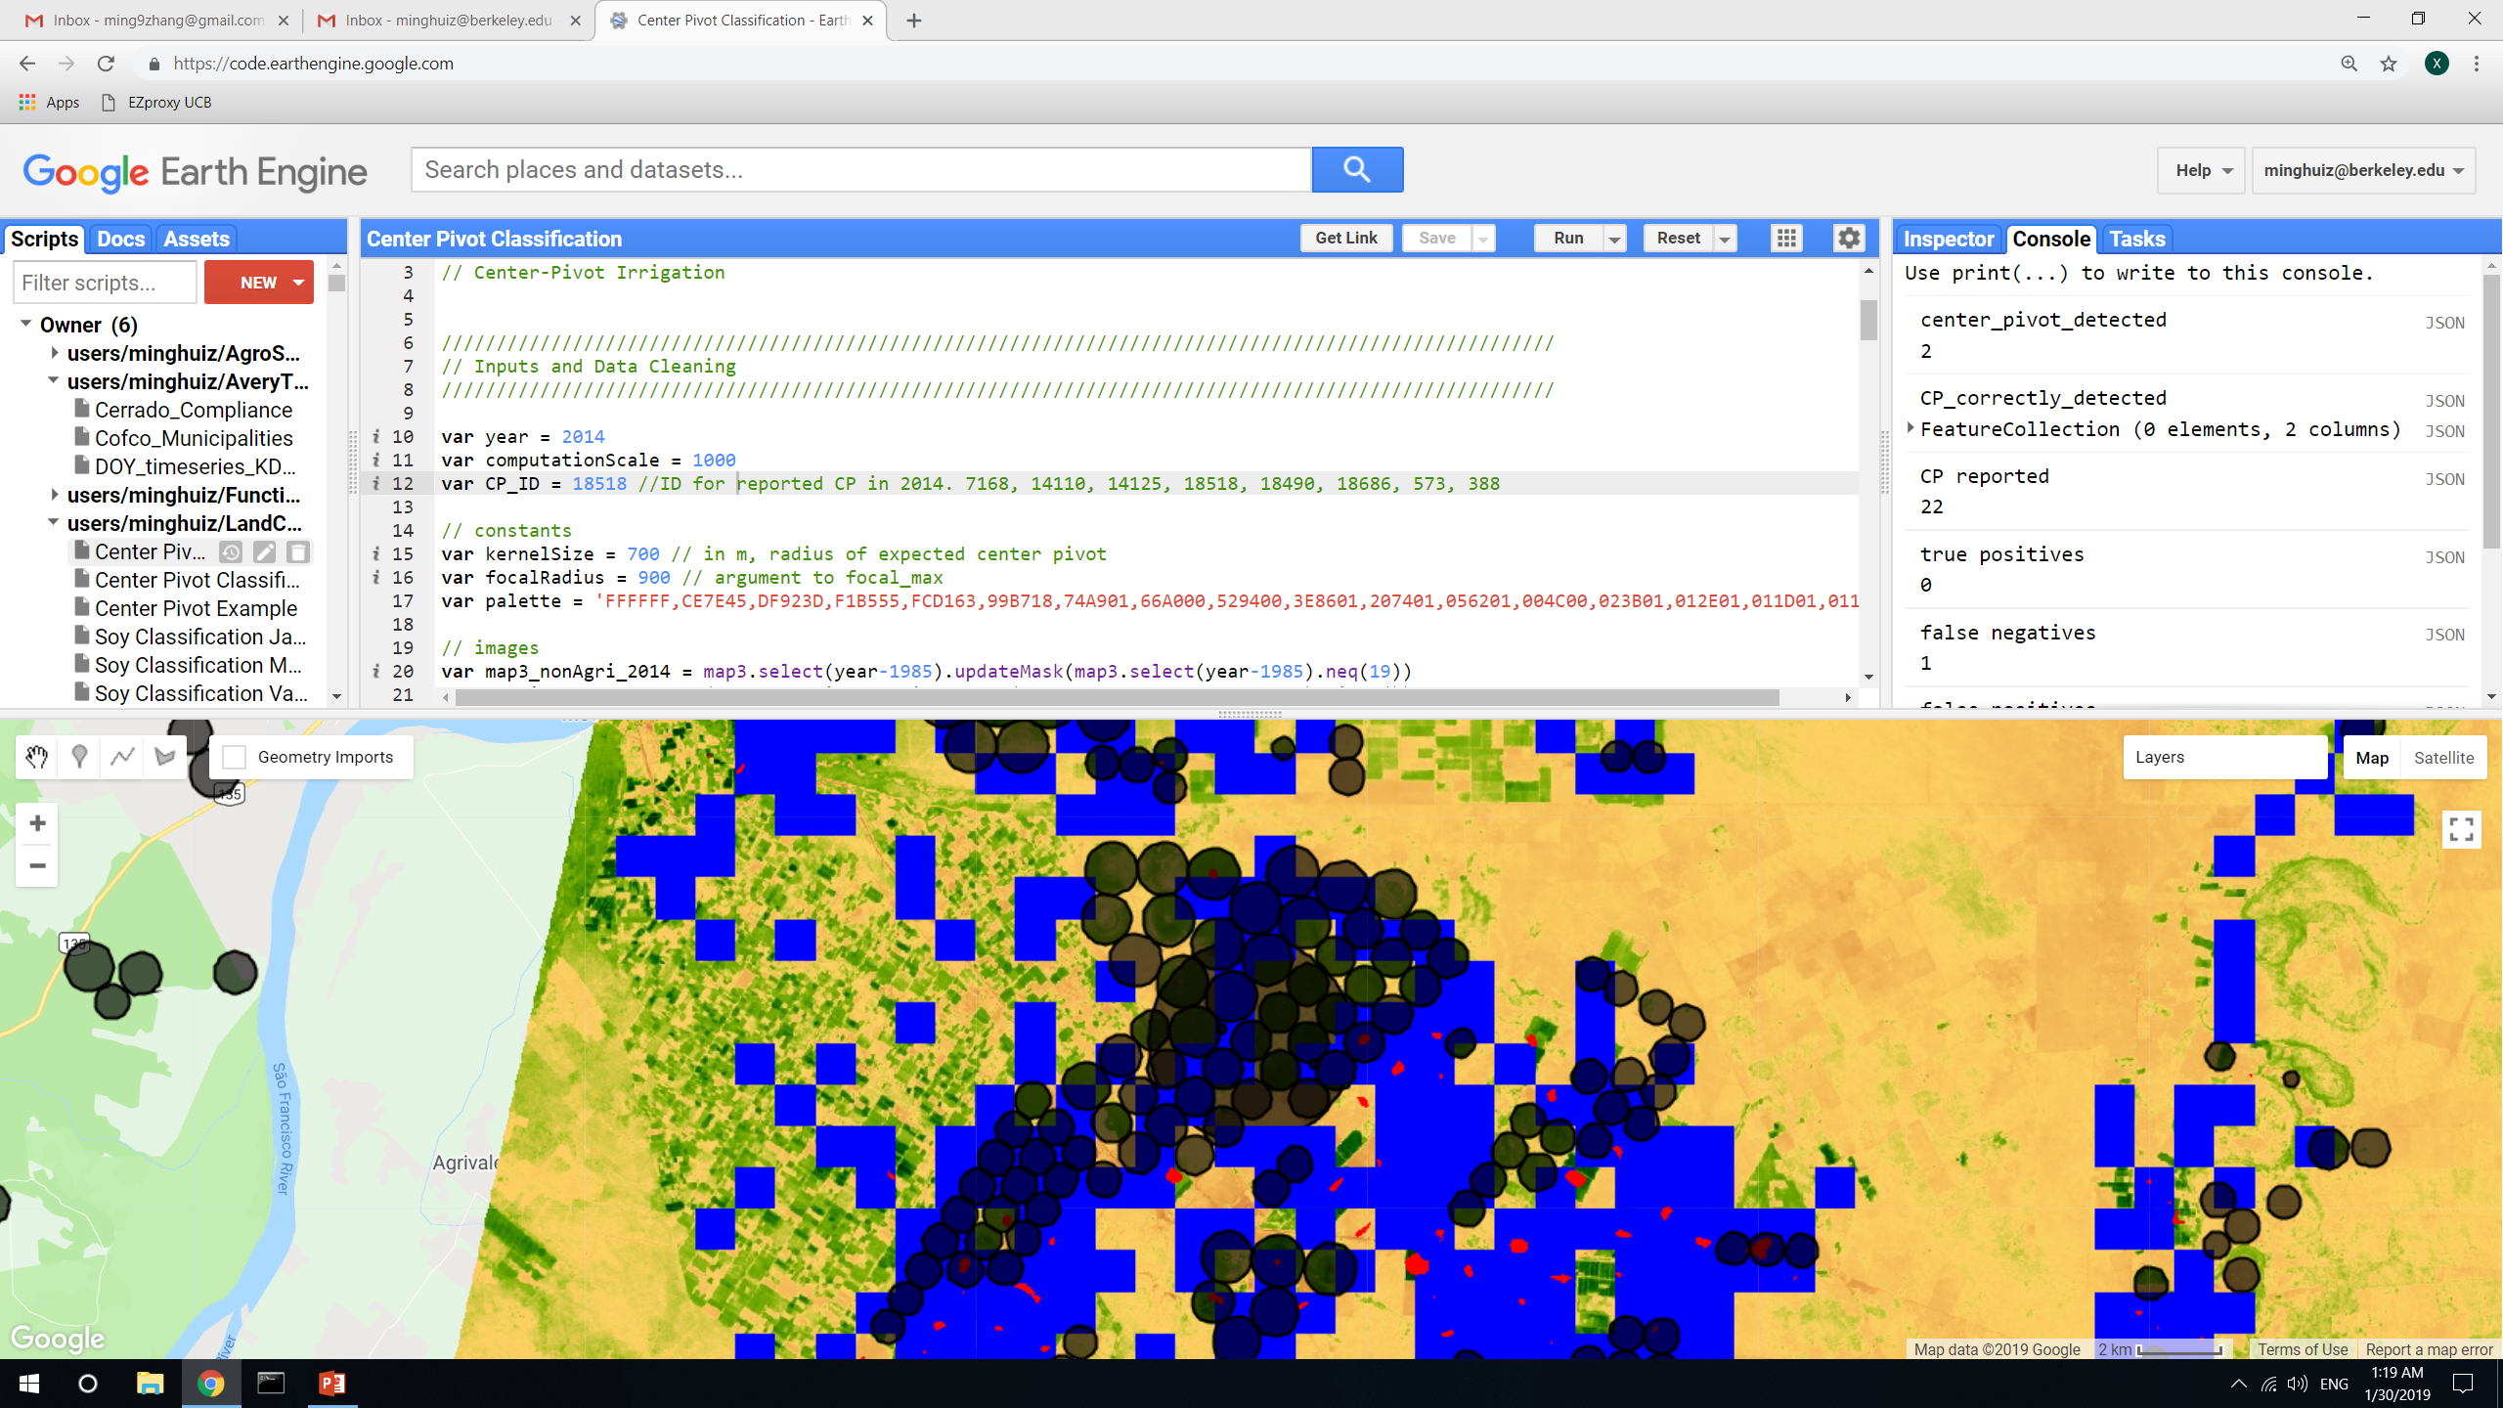
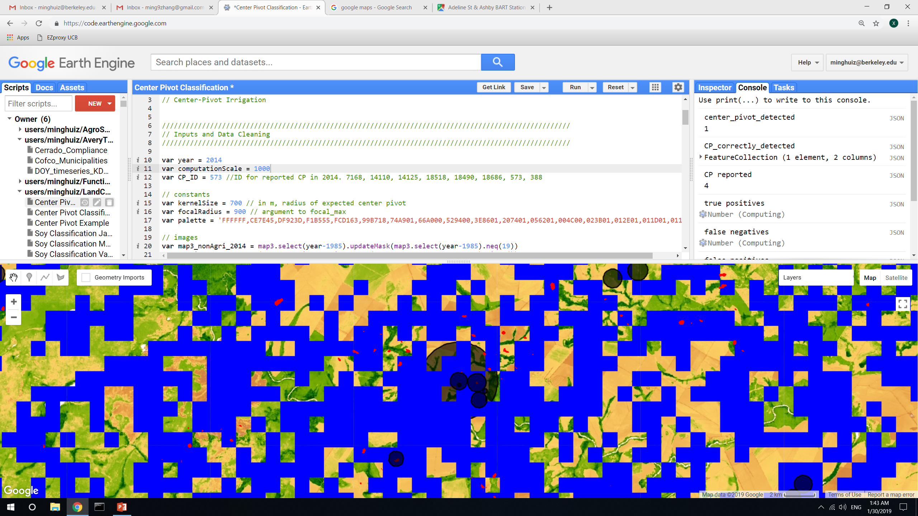
Brazil center pivot edge detection: using EVI in September 2013
Testing randomly chosen locations for the reduceToVectors() scale and reprojection scale:
Only at 30m do the blue (reprojected) have any hope of matching up with the red (raw kernel peaks) which translates well into detected CP features
Detected CPs = 1
Detected CPs = 0
Detected CPs = 4
Observations:
Above 30m scale in reduceToVectors(), the blue (post projection) doesn’t match up with the original (red) kernel peaks. This means the CP features after reducetoVectors() are very inaccurate. At 500m the features don’t line up with the original red dots; at 1000m the blue blends together and the number of detected features decrease because of it.
At 30m scale, even if fewer CPs are detected, at least they’re not shifted from the red and the detected CP features line up well with the original kernel peaks. Also, no blue pixels (post-projection) seem to be ‘made out of thin air’, i.e. blue pixels always align with the red ones.
TAKEAWAY: 30m is the only scale for reduceToVectors()
30m
Detected CPs = 8
Detected CPs = 4
Detected CPs = 6
500m
Detected CPs = 1
Detected CPs = 2
Detected CPs = 1
1000m
Target_FID = 14110
Target_FID = 18518
Target_FID = 573
In GEE: LandCover/Center Pivot Classification

Slide 17
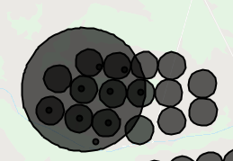
Center pivot detection: accuracy assessment at point level
Masked out centroids if it didn’t fall into map3 agri class, but didn’t’ mask out any reported CPs
 | Reported CP | Reported not CP
Detected CP | Spatial join detected features and reported features -> intersection Accuracy = intersection/(reported CPs) | False positive = (detected CPs – intersection)/(reported CPs)
Detected not CP | False negative = (reported CPs – intersection)/(reported CPs) | N/A
Big circle = 2km radius test area
Small circles = reported CP
Points = detected CP
In GEE: LandCover/Center Pivot Classification v3

Slide 18
Center pivot detection: accuracy assessment at area level
Ultimately, will want to get rid of entire areas of CPs because don’t know what radius to associate with each detected CP centroid. Assume need to get rid of an area equal to radius = max of local CPs from the detected centroid (i.e. want to avoid irrigation as much as possible)
Masked out both reported CP areas and detected CP areas outside of mapbiomas3 agri class
 | Reported CP | Reported not CP
Detected CP | Mask reported image with detected image -> intersection Accuracy = intersection area/(reported area) | False positive = (detected area – intersection area)/(reported area)
Detected not CP | False negative = (reported area – intersection area)/(reported area) | N/A
In GEE: LandCover/Center Pivot Classification v3

Slide 19
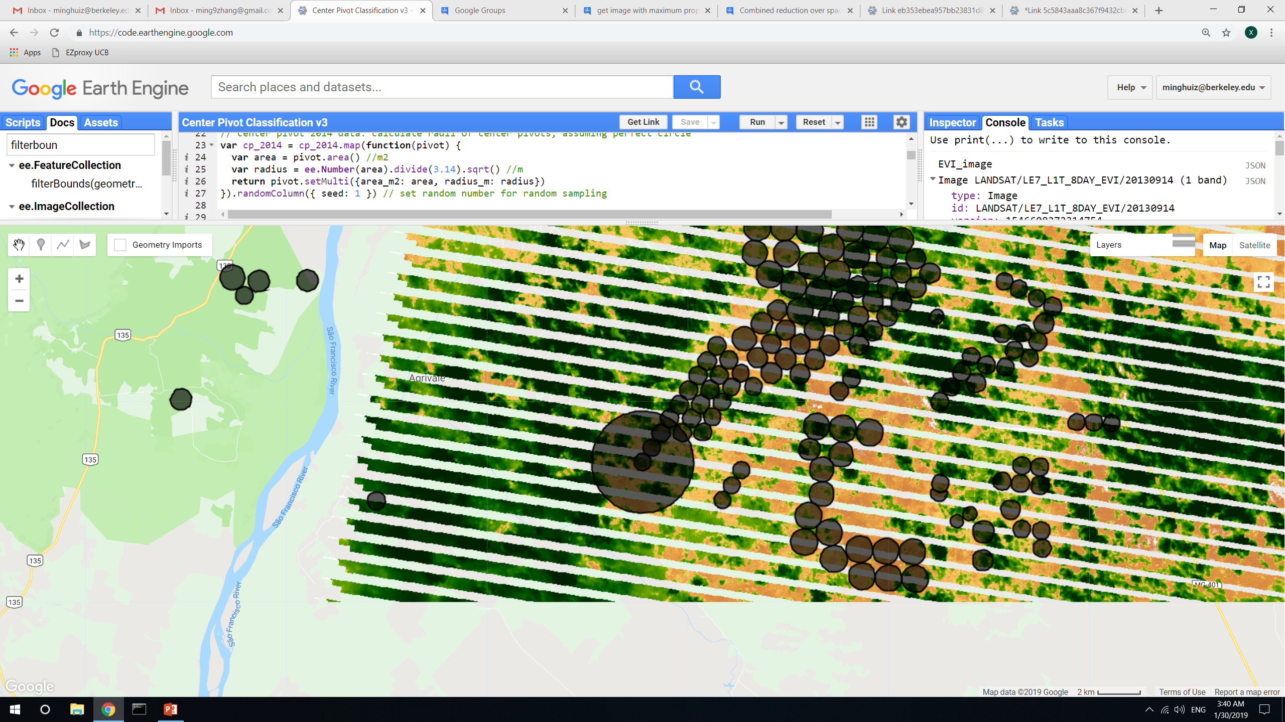
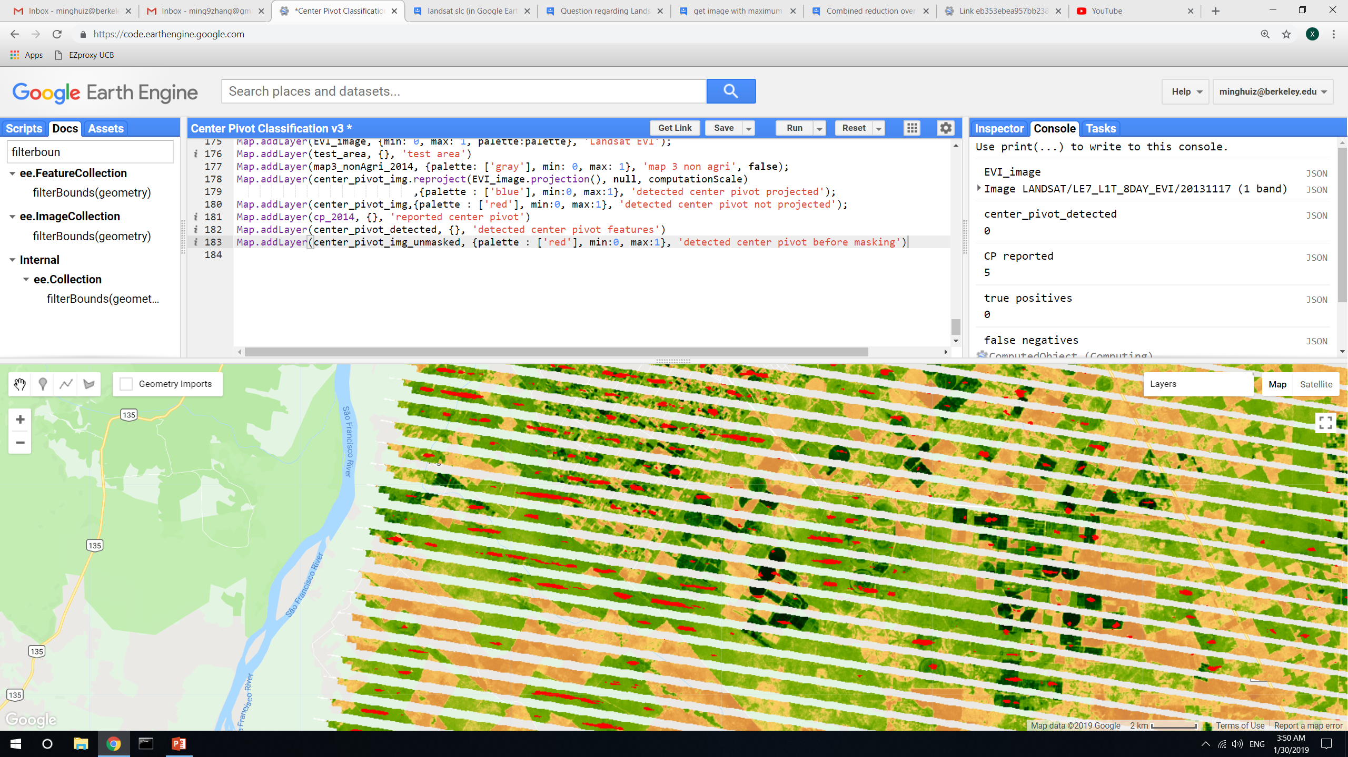
Center pivot detection: using image with max variance in EVI as the analysis input; SLC off images in Landsat 7
Here, the maximum variance in EVI occurred in September 2013 (from Landsat 7), but clearly there’s no obvious center pivot to be found and the image is SLC-off
SLC-off images return no detected center pivot because the edge masking takes them out. The red below is pre-edge masked kernel peaks. So don’t need to worry about SLC edges creating false positives. However there’s no attribute in EVI composite that allows filtering out SLC off images.
TAKEAWAY: date of max EVI doesn’t correspond to best time to detect center pivot; is probably a time of mostly natural vegetation and SLC off images. Probably need multiple days because (1) different center pivots are active at different times, (2) avoid SLC off images.
TAKEAWAY: don’t use Landsat 7, it dumps too many valuable images
In GEE: LandCover/Center Pivot Classification v3

Slide 20
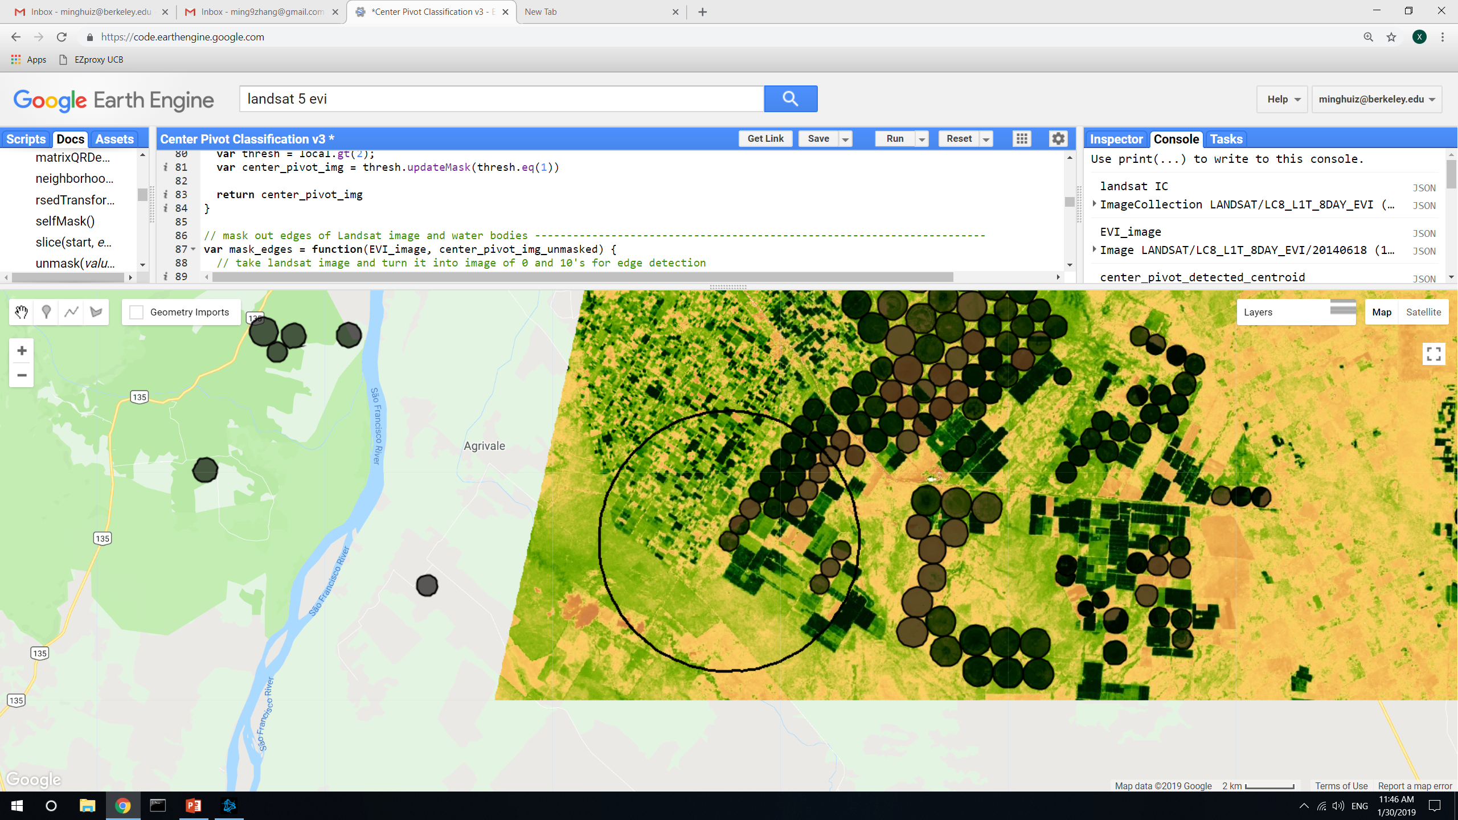
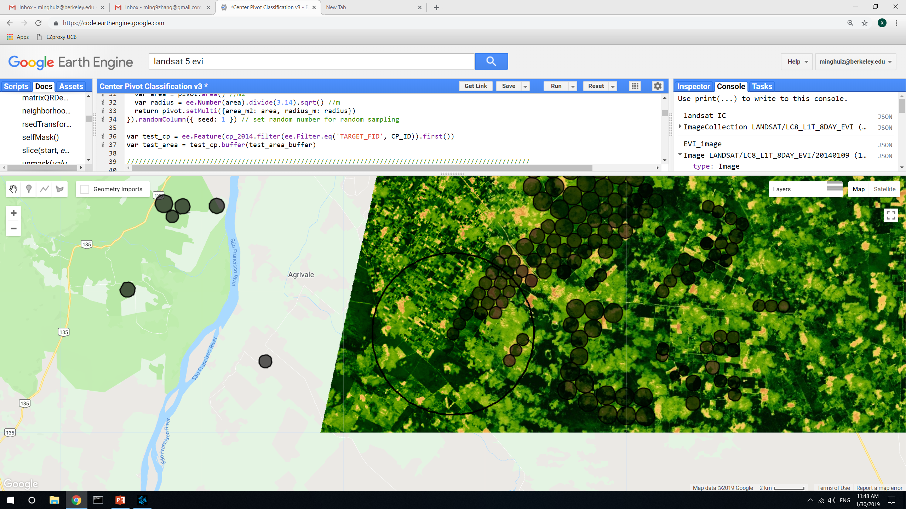
Center pivot detection: using image with max variance in EVI as the analysis input
Since a lot of the EVI variance from previous slide seemed to come from natural vegetation, masked out nonagri areas using map3
A lot of variability still comes from neighboring non-center pivot farmland, and even date of max EVI doesn’t highlight all the center pivots
TAKEAWAY: masking out nonagri improves choice of max EVI variance date, but still doesn’t really improve accuracy. Try to do analysis on the max EVI variance image over various time segments, like early season and late season, or by month/week. Overlay the detected CP images and if a detected CP persists in at least three images, call it CP.
Without masking out nonagri
Date: Jan 9
Area accuracy: 0.25
Masking out nonagri
Date: June 18
Area accuracy: 0.27
In GEE: LandCover/Center Pivot Classification v3

Slide 21
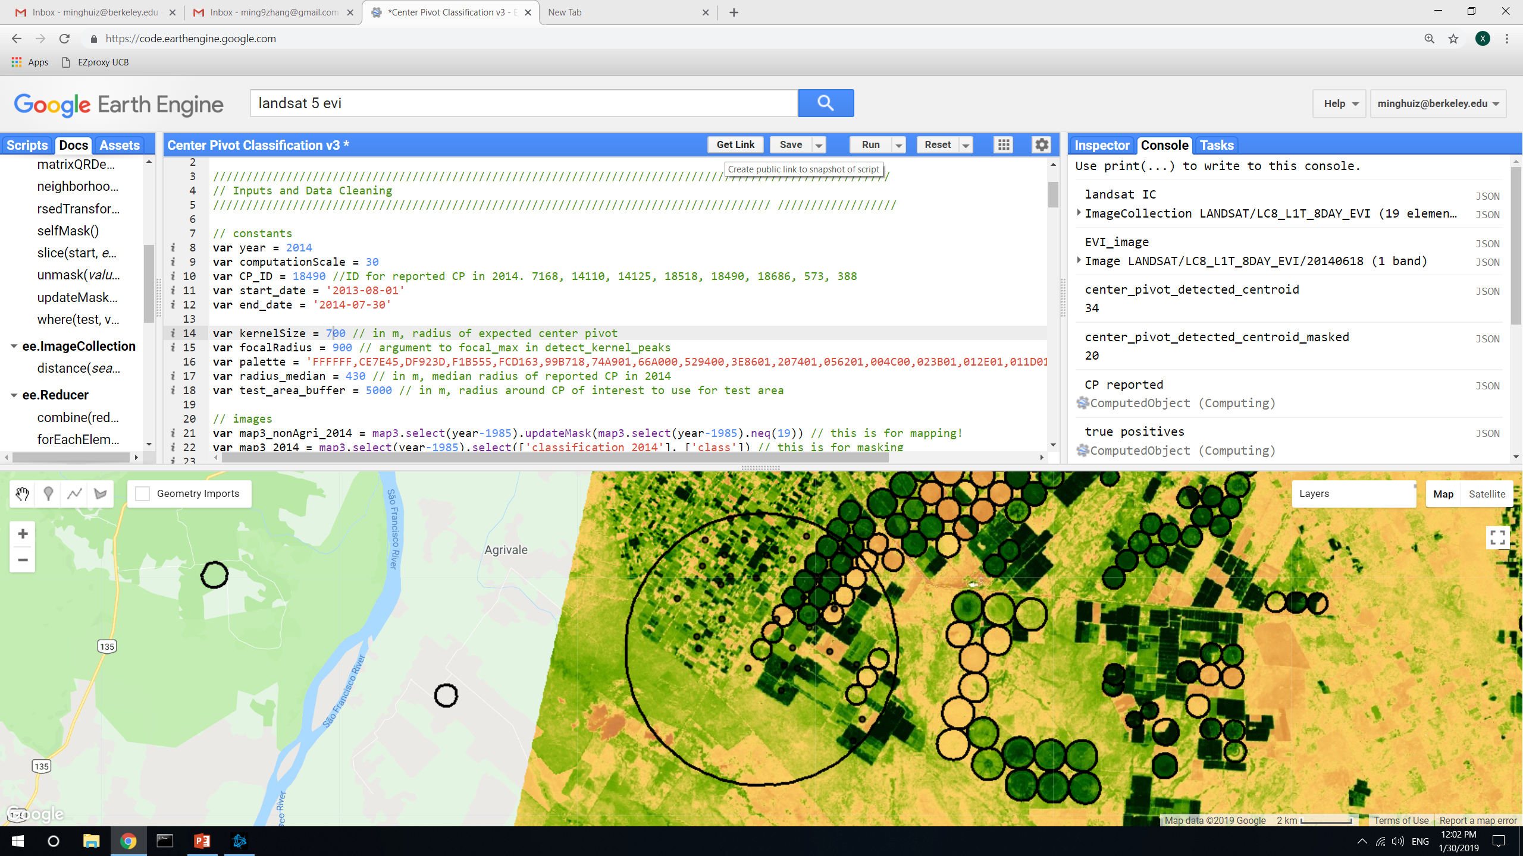
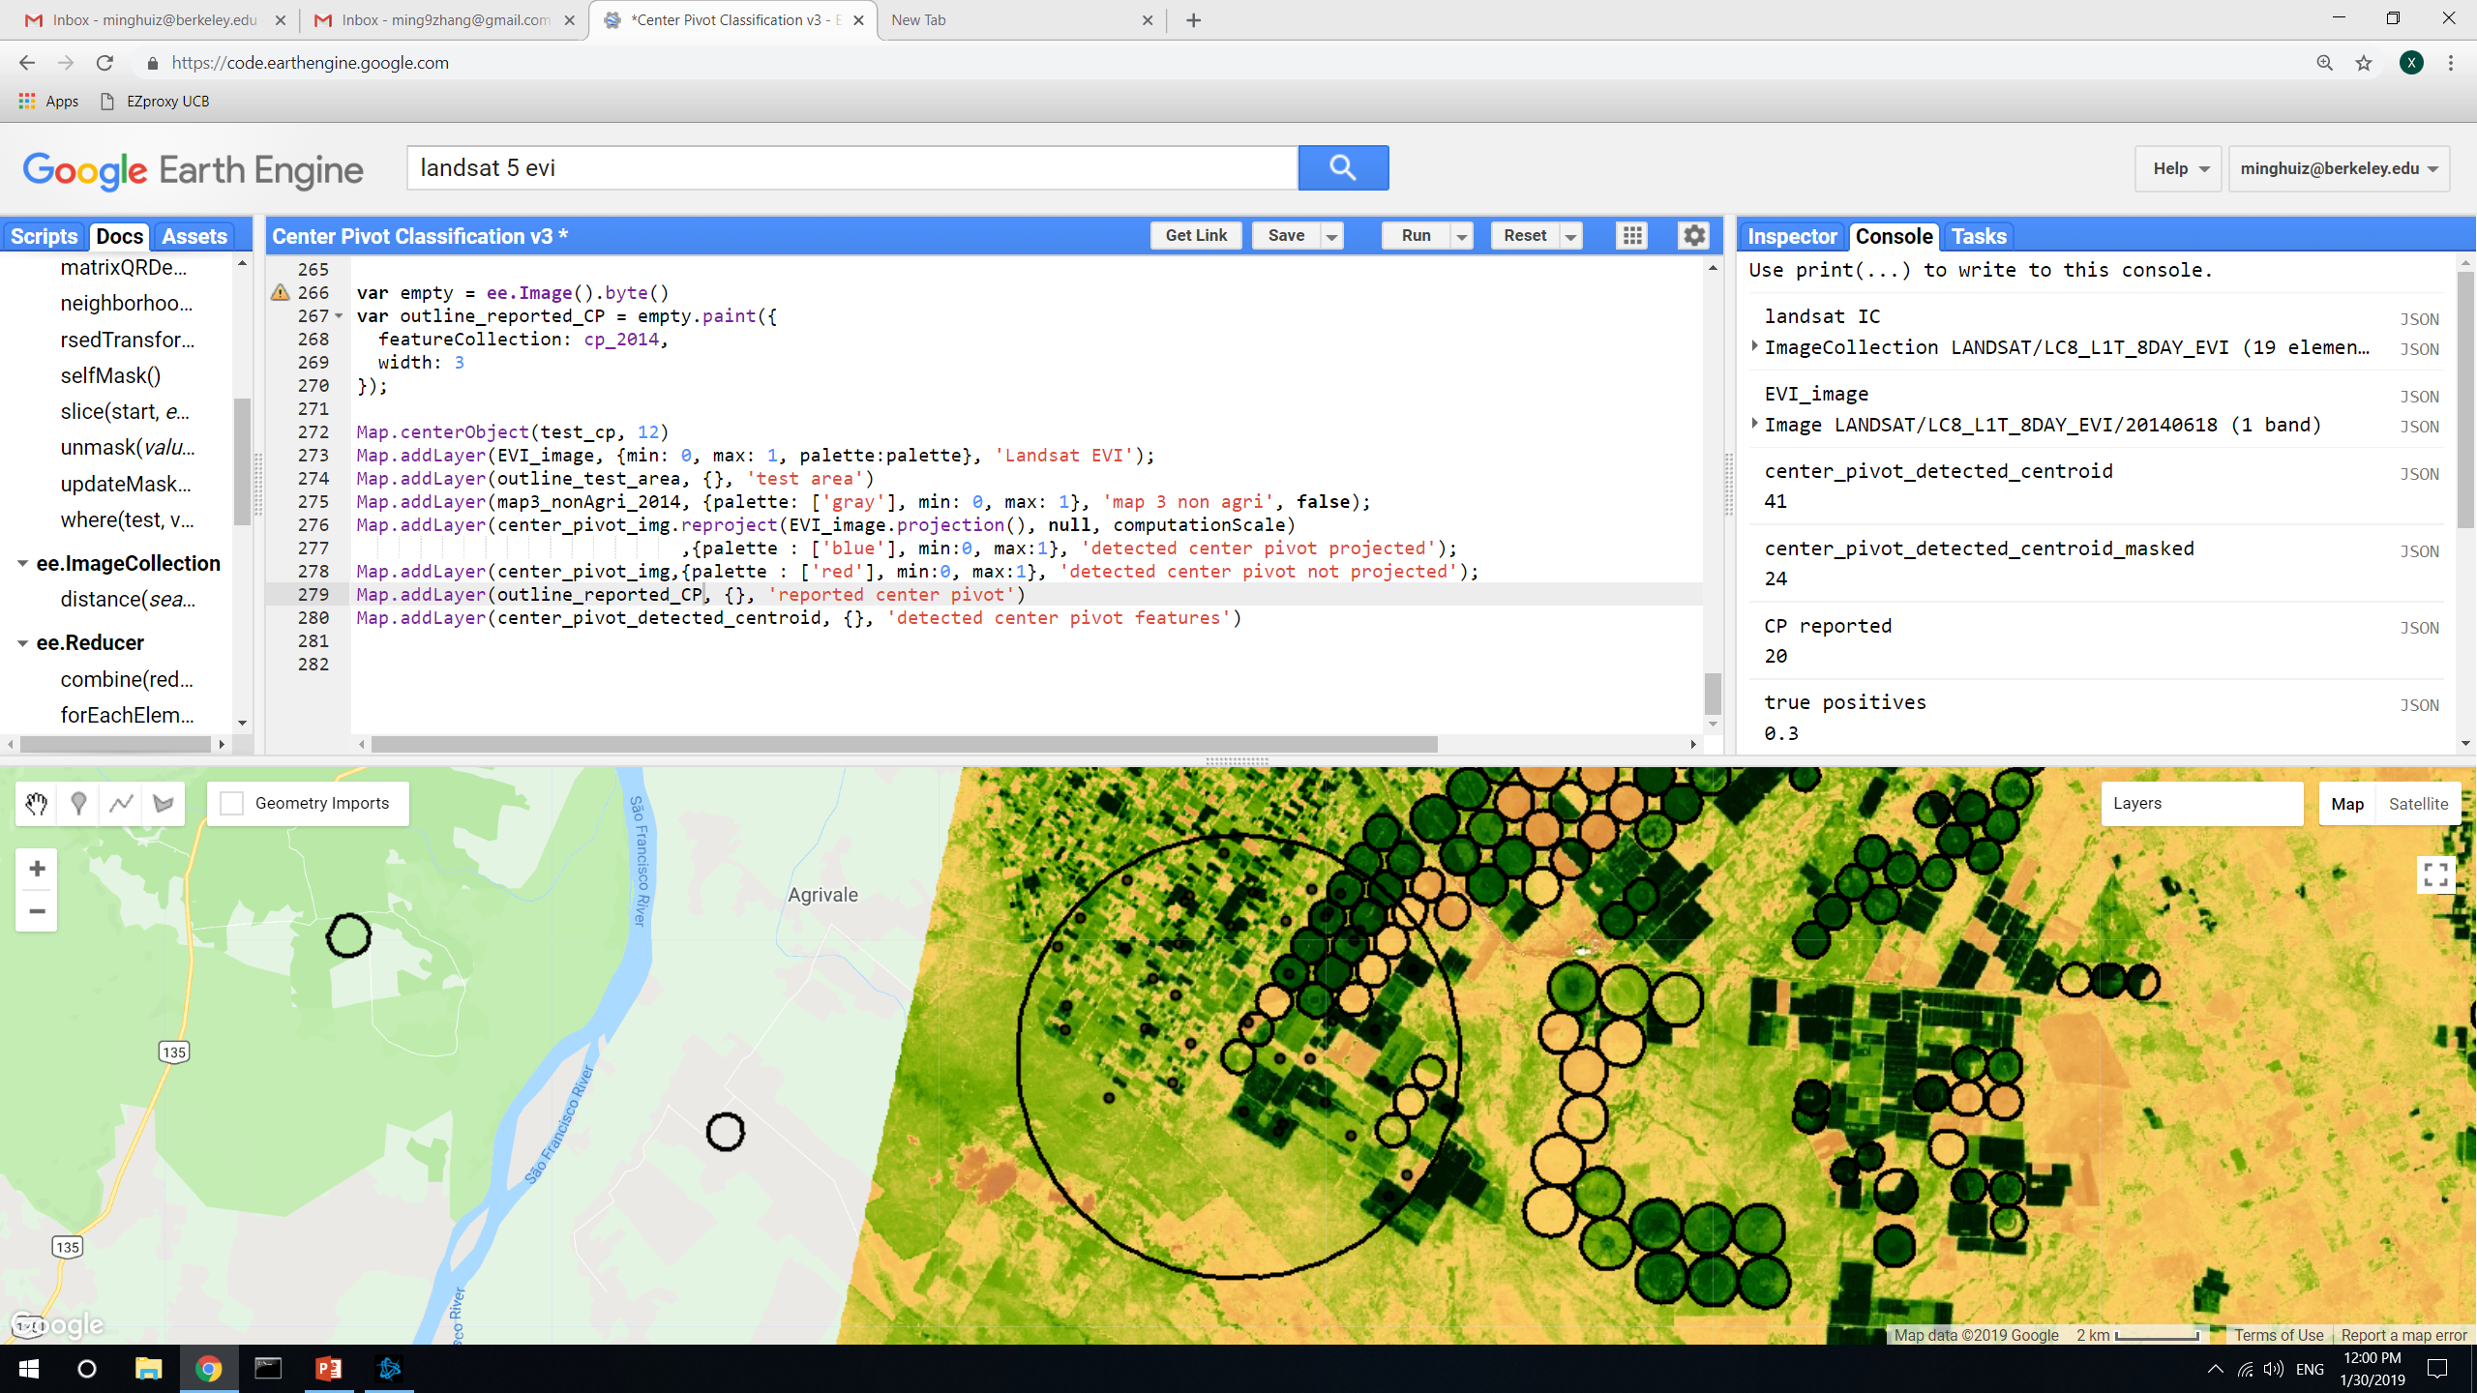
Center pivot: the effect of kernel size
TAKEAWAY: kernel size matters, and also anything heterogeneous (including heterogeneous farmland) would be detected as center pivot. Can we assume that the size of center pivot doesn’t change wrt 2014? That way we can set the kernel size specific to the local region.
Kernel size = 700m
Kernel size = 400m
In GEE: LandCover/Center Pivot Classification v3

Slide 22
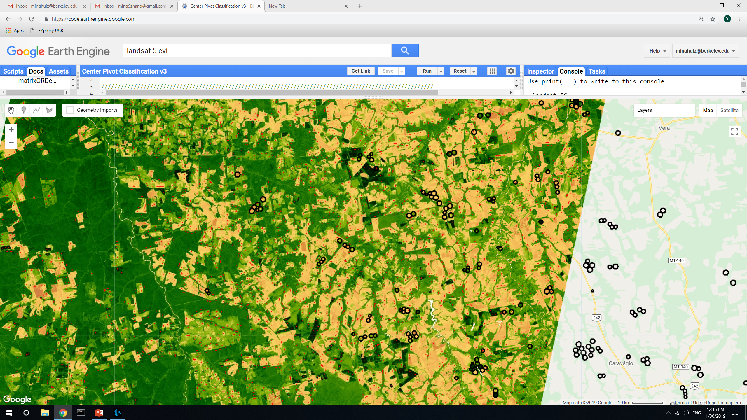
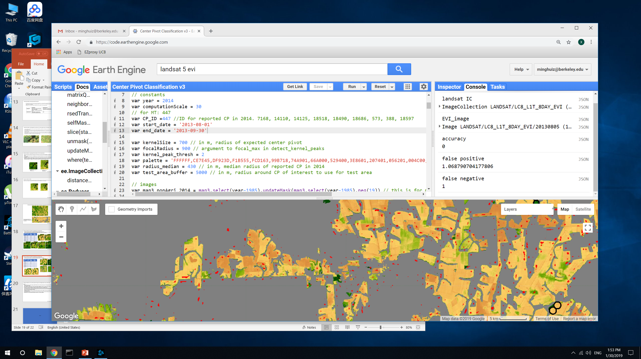
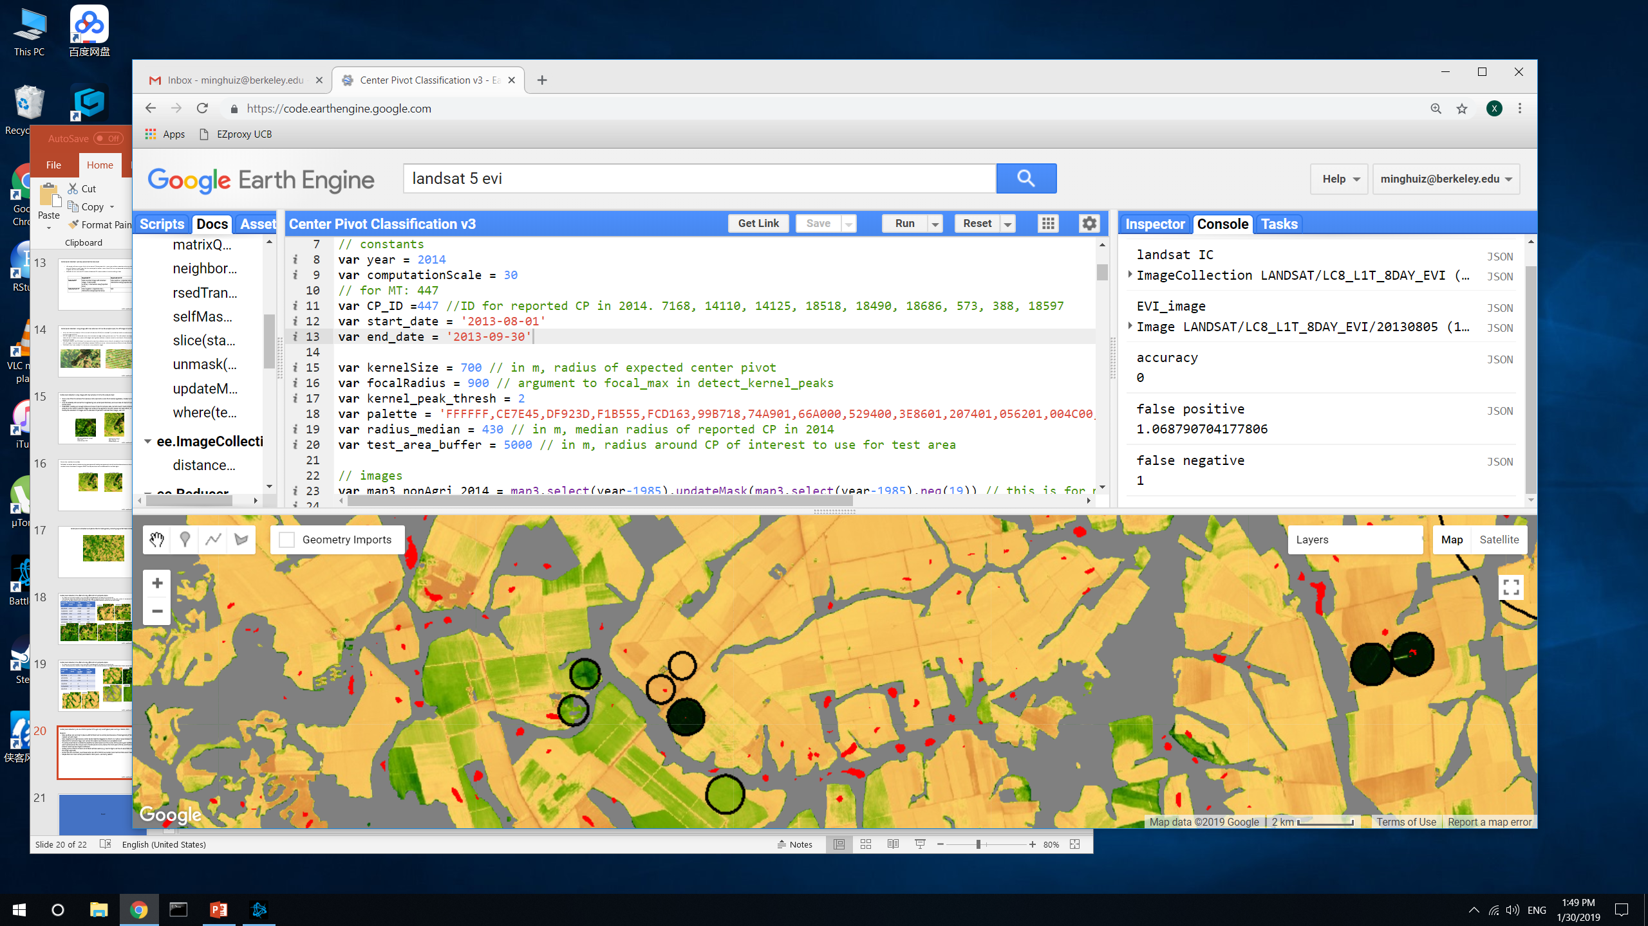
Center pivot is detected everywhere there’s heterogeneity, including regular farmland in Mato Grosso
Gray is nonagri; there’s still a lot of ‘detected’ (red) CPs that are on rainfed agri, especially near the edges and at heterogeneous fields, and can’t be masked out
In GEE: LandCover/Center Pivot Classification v3

Slide 23
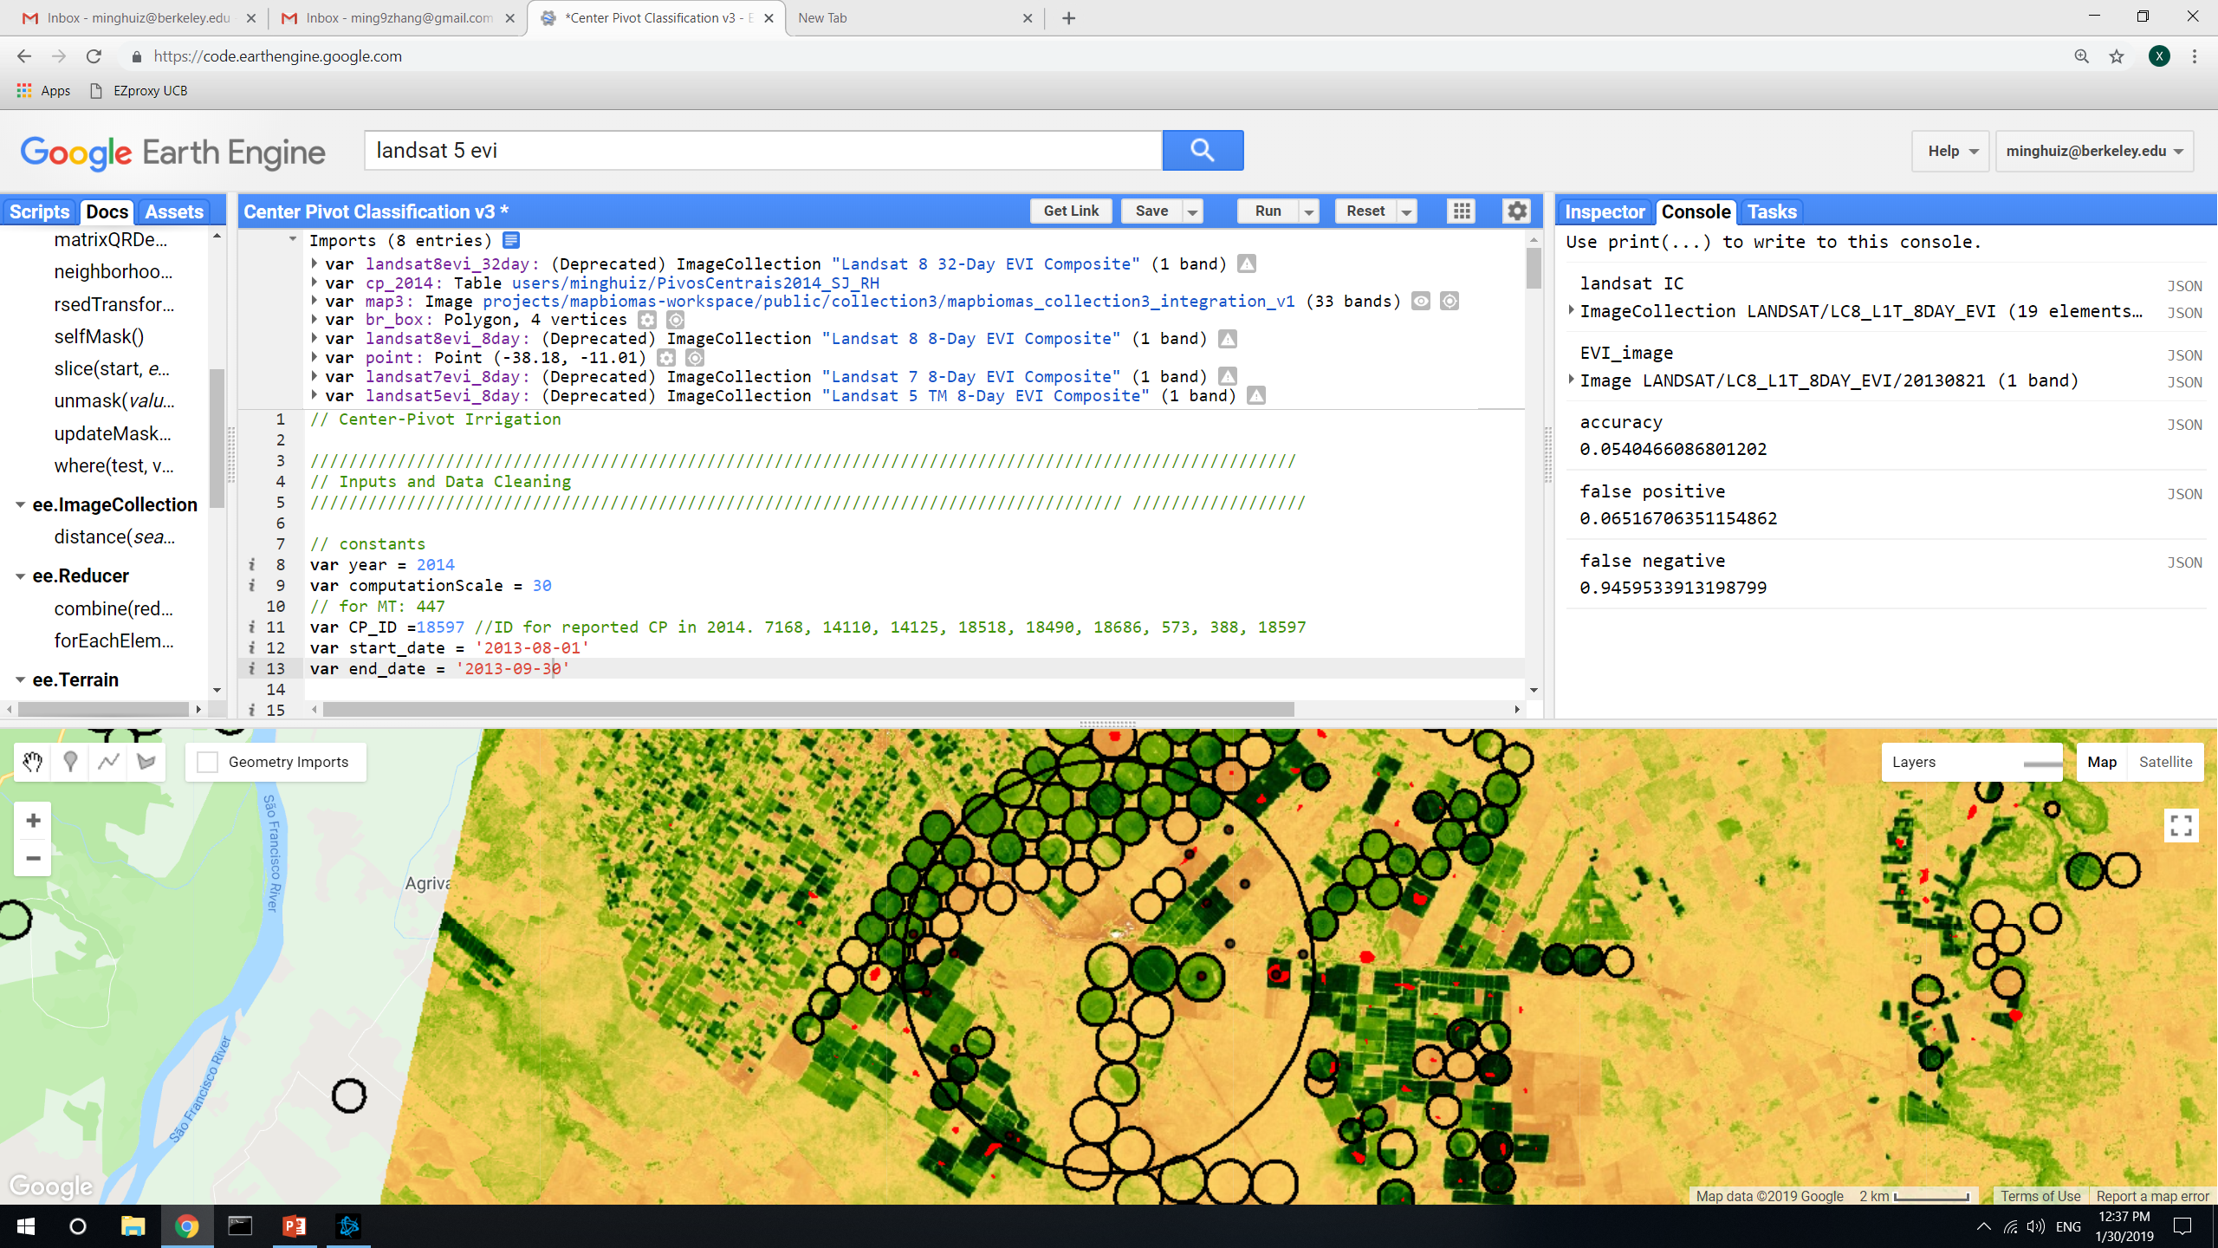
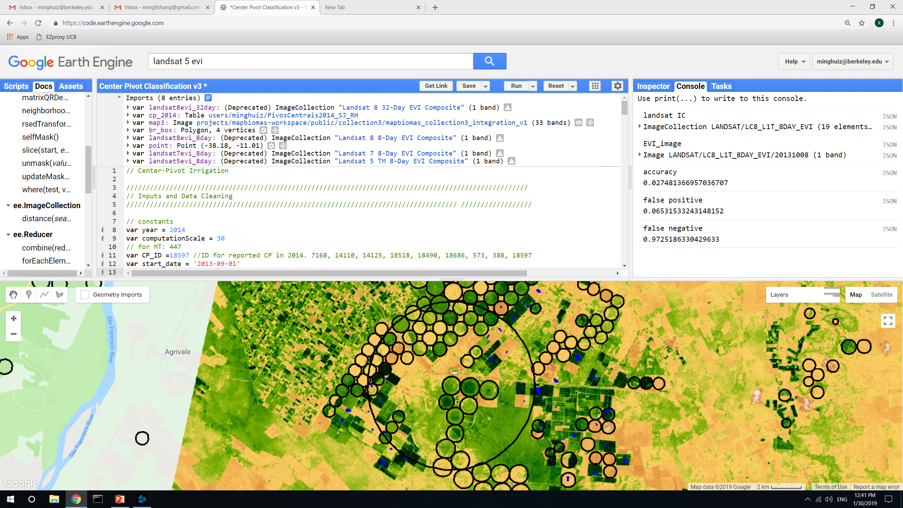
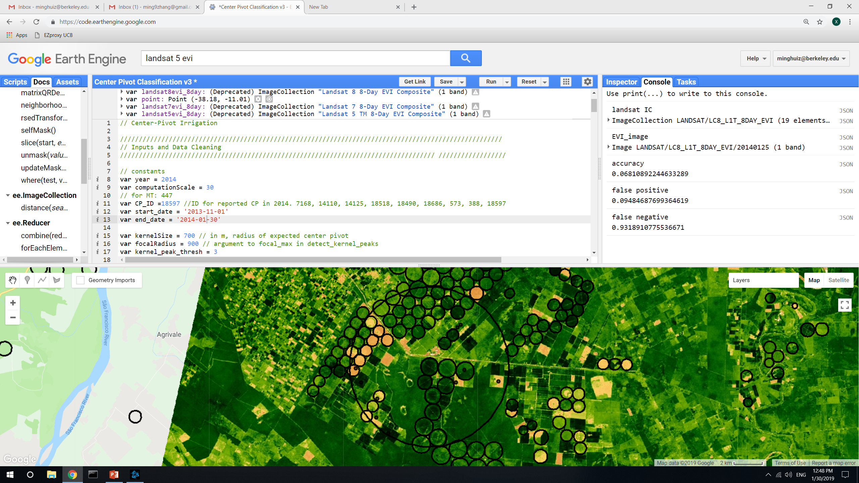
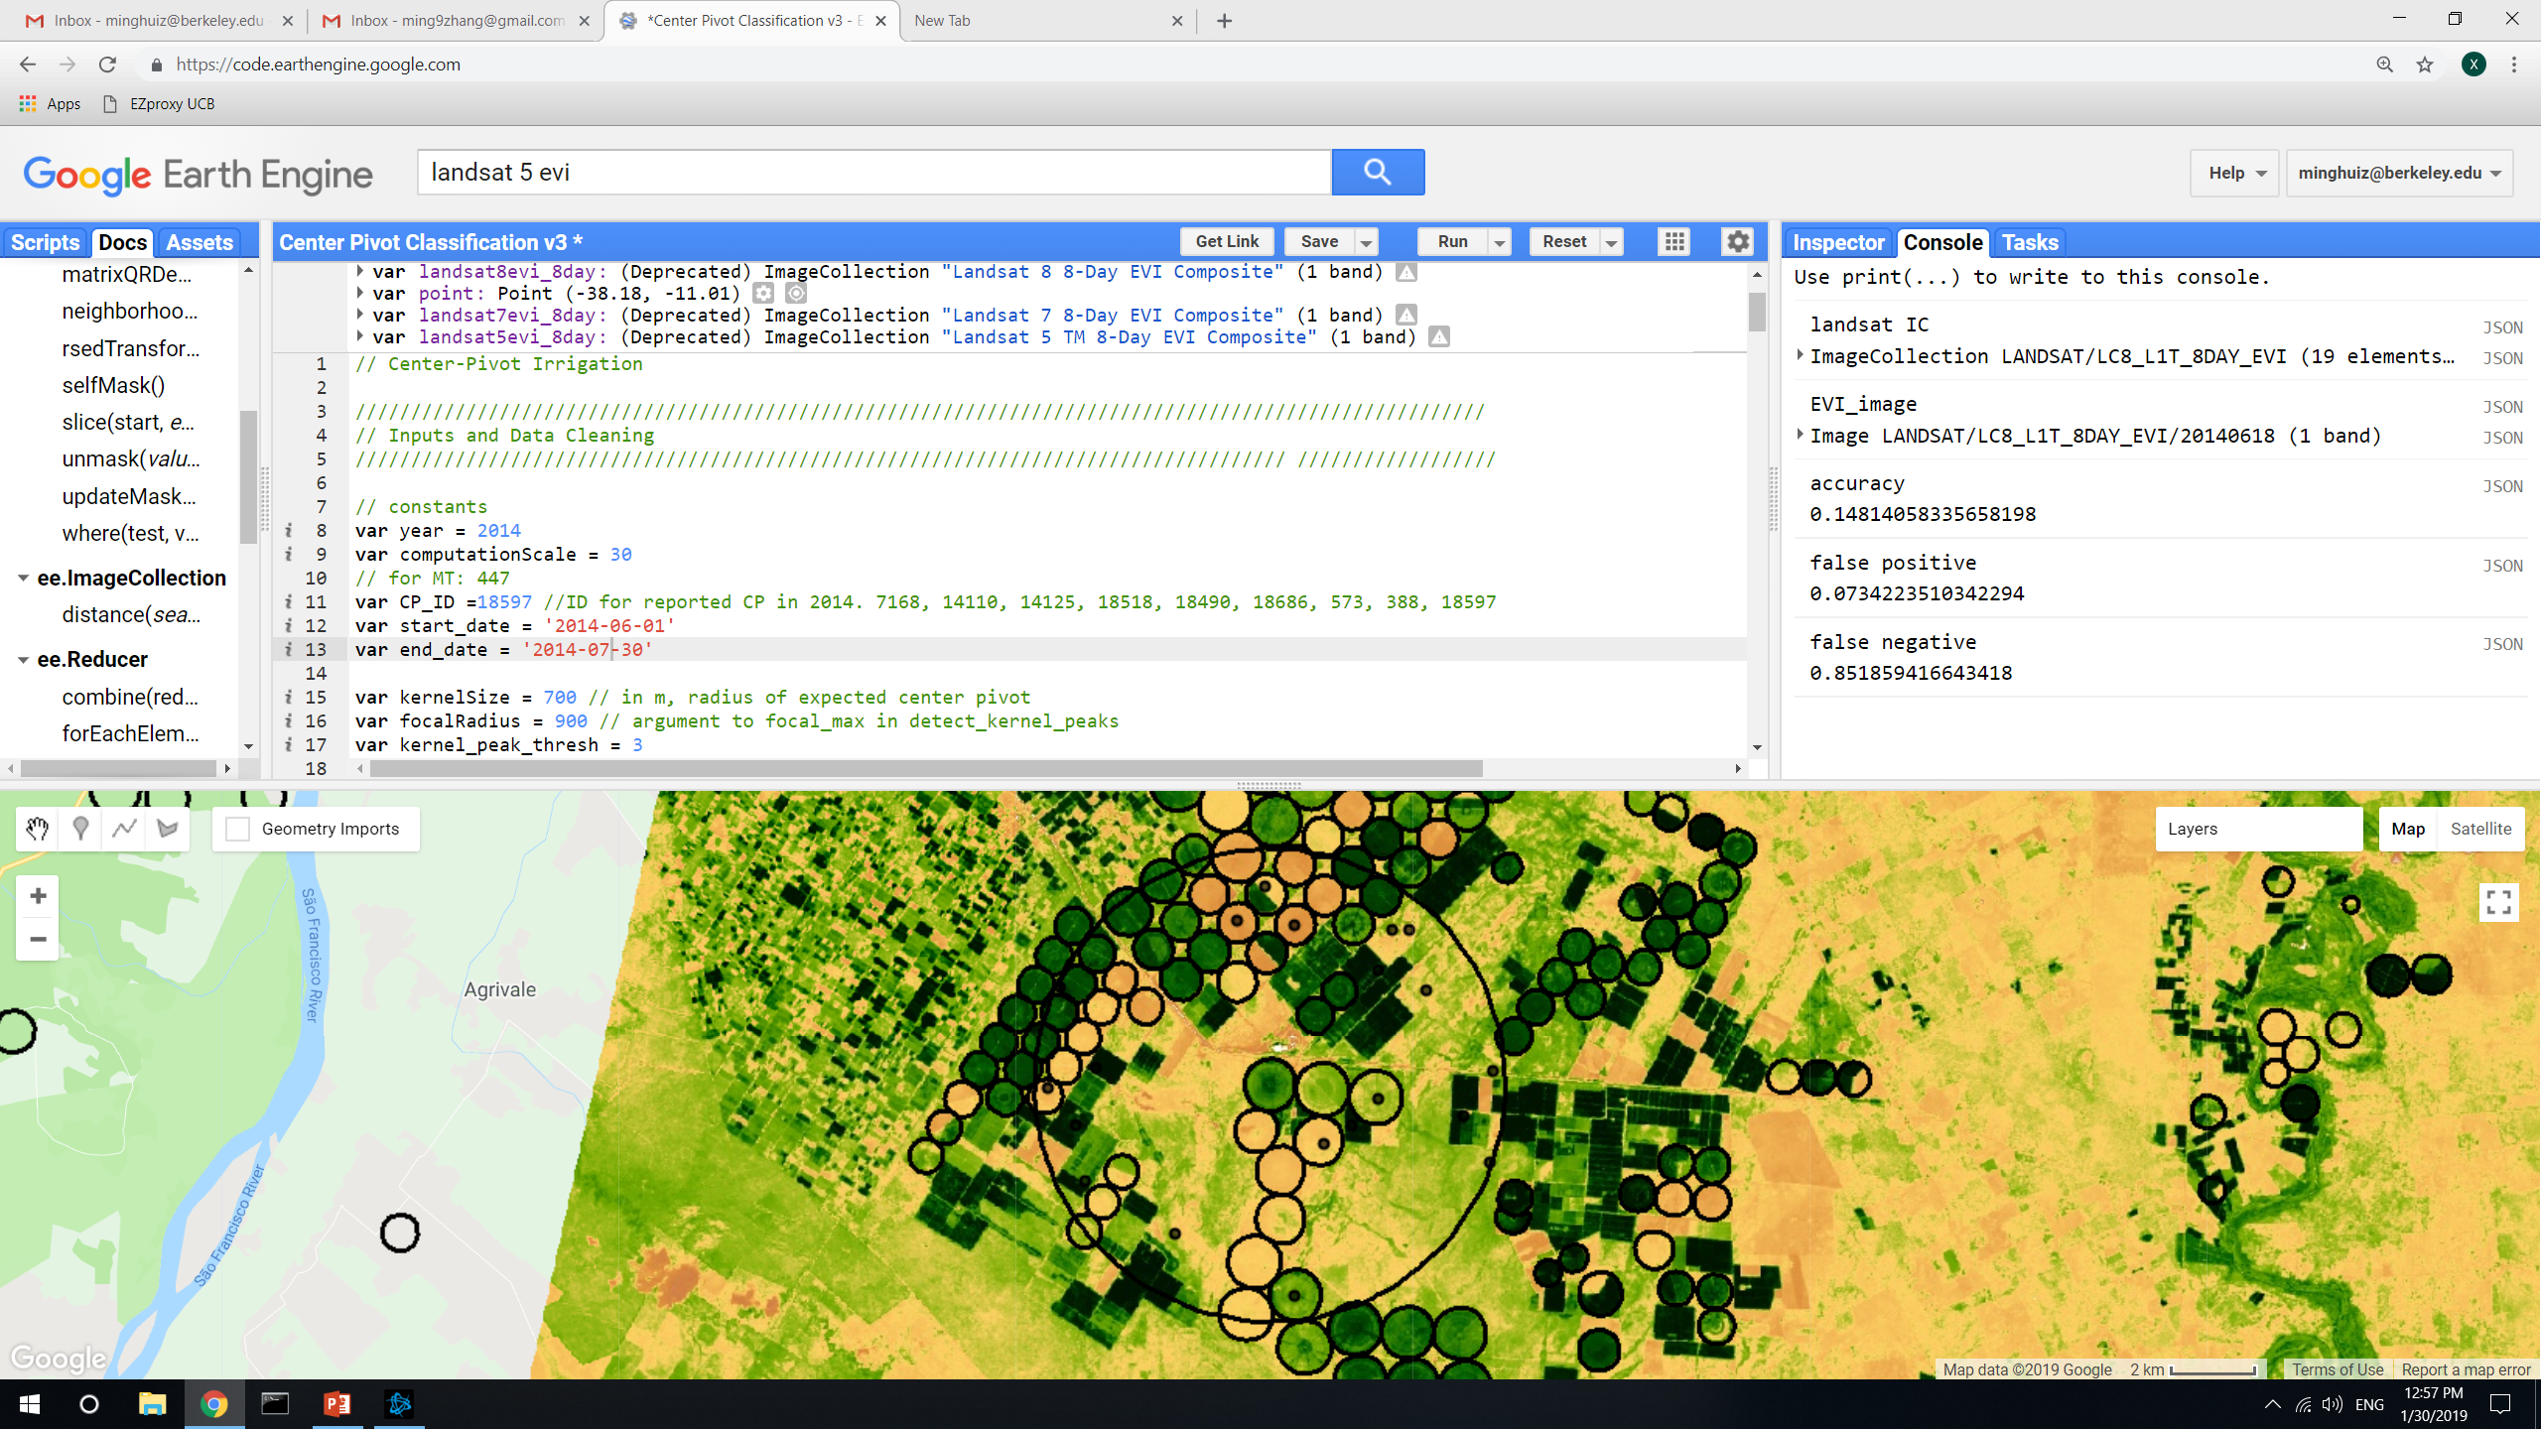
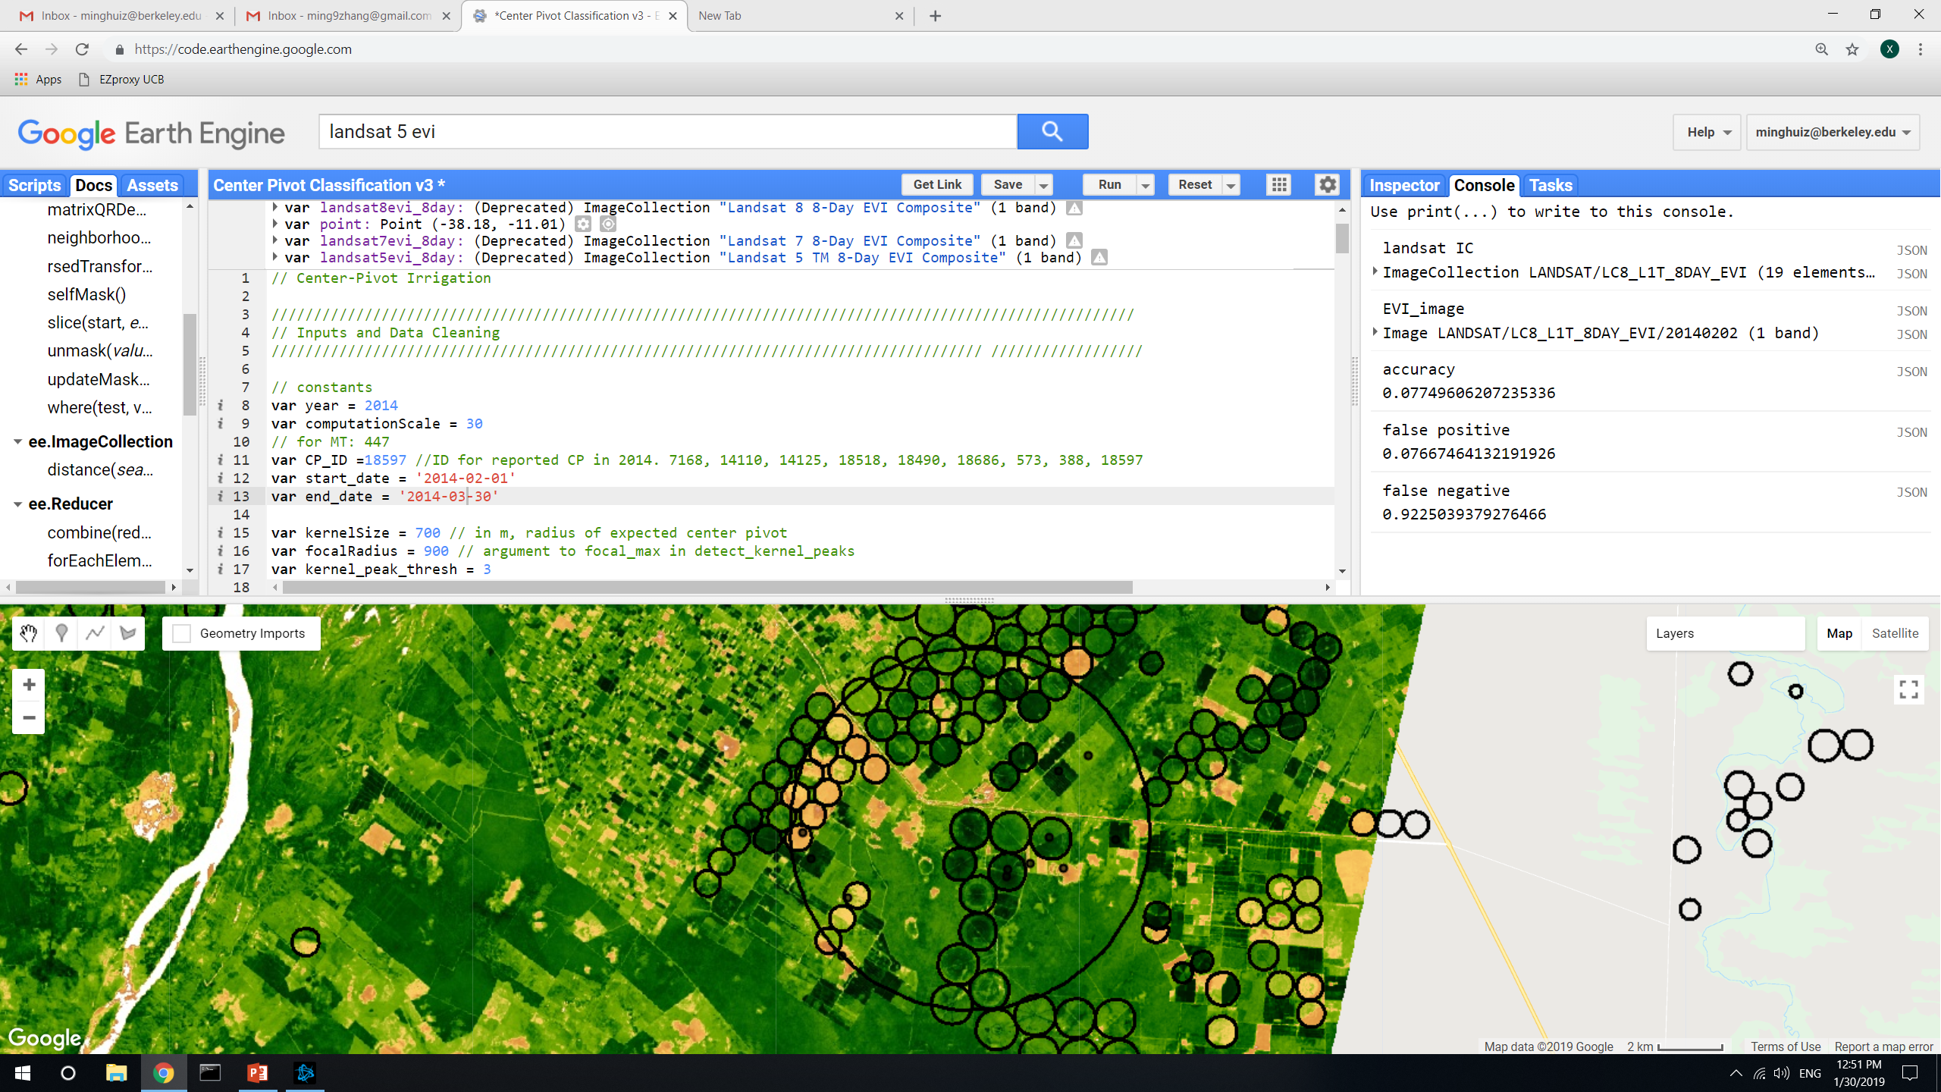
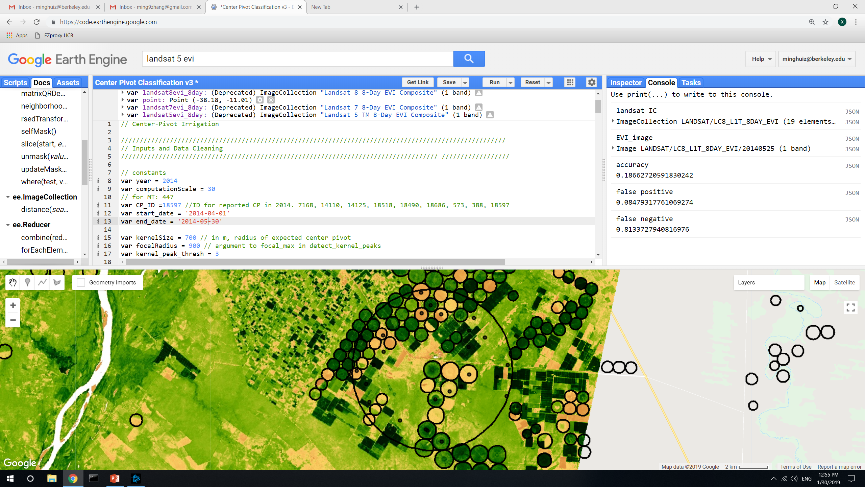
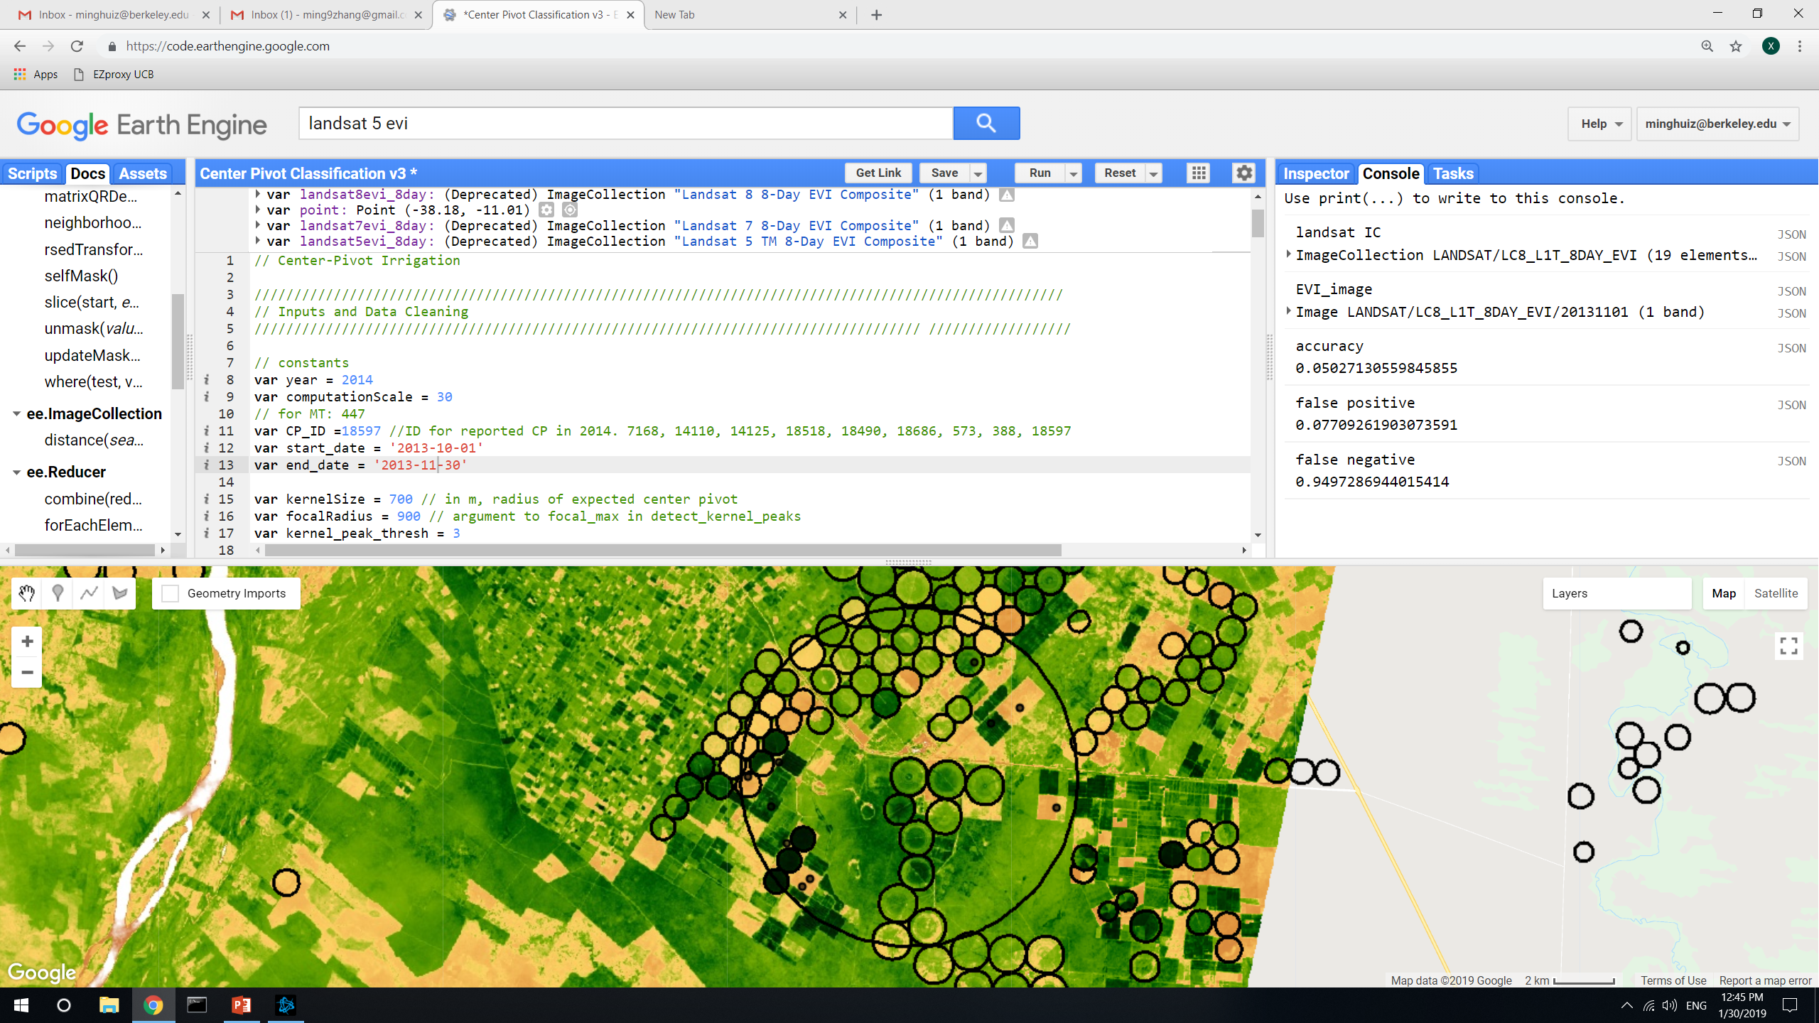
Center pivot detection: the effect of using different EVI composite dates
For these, took out map3 nonagri in both reported CP and detected CP. Accuracy is in terms of area
A lot of center pivots have never been detected using images throughout the year. These are for kernel_peak_thresh = 3, but even at 2 the false negative is around 0.8. The false positive is low here because a lot of the detected places are masked out by map3 nonagri
Composite date | Accuracy (area) | False positive (area) | False negative (area)
8/1/2013 | 0.05 | 0.065 | 0.95
10/8/2013 | 0.027 | 0.065 | 0.97
11/1/2013 | 0.05 | 0.077 | 0.95
2/2/2014 | 0.08 | 0.077 | 0.92
5/25/2014 | 0.18 | 0.08 | 0.8
6/18/2014 | 0.15 | 0.07 | 0.85
8/1/2013
10/8/2013
1/25/2014
6/18/2014
2/2/2014
5/25/2014
11/1/2013
In GEE: LandCover/Center Pivot Classification v3

Slide 24
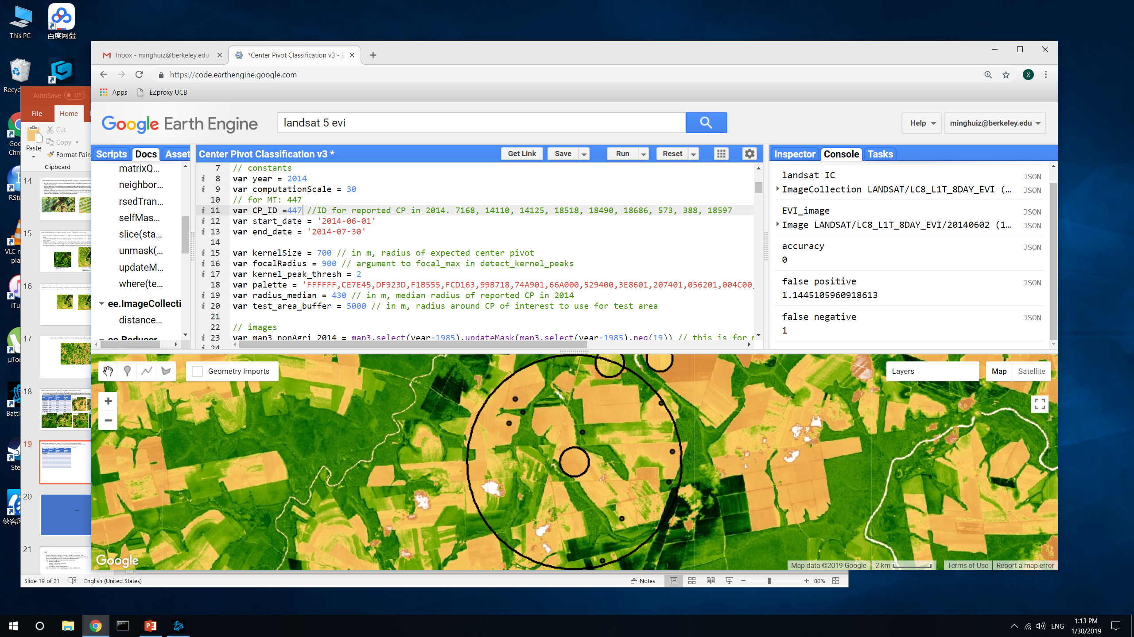
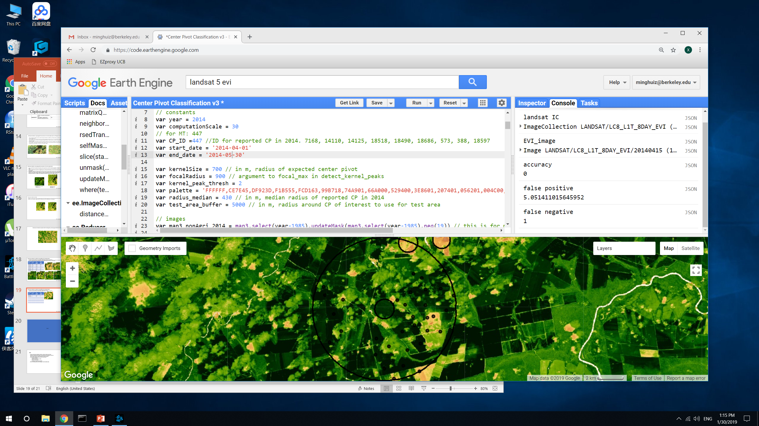
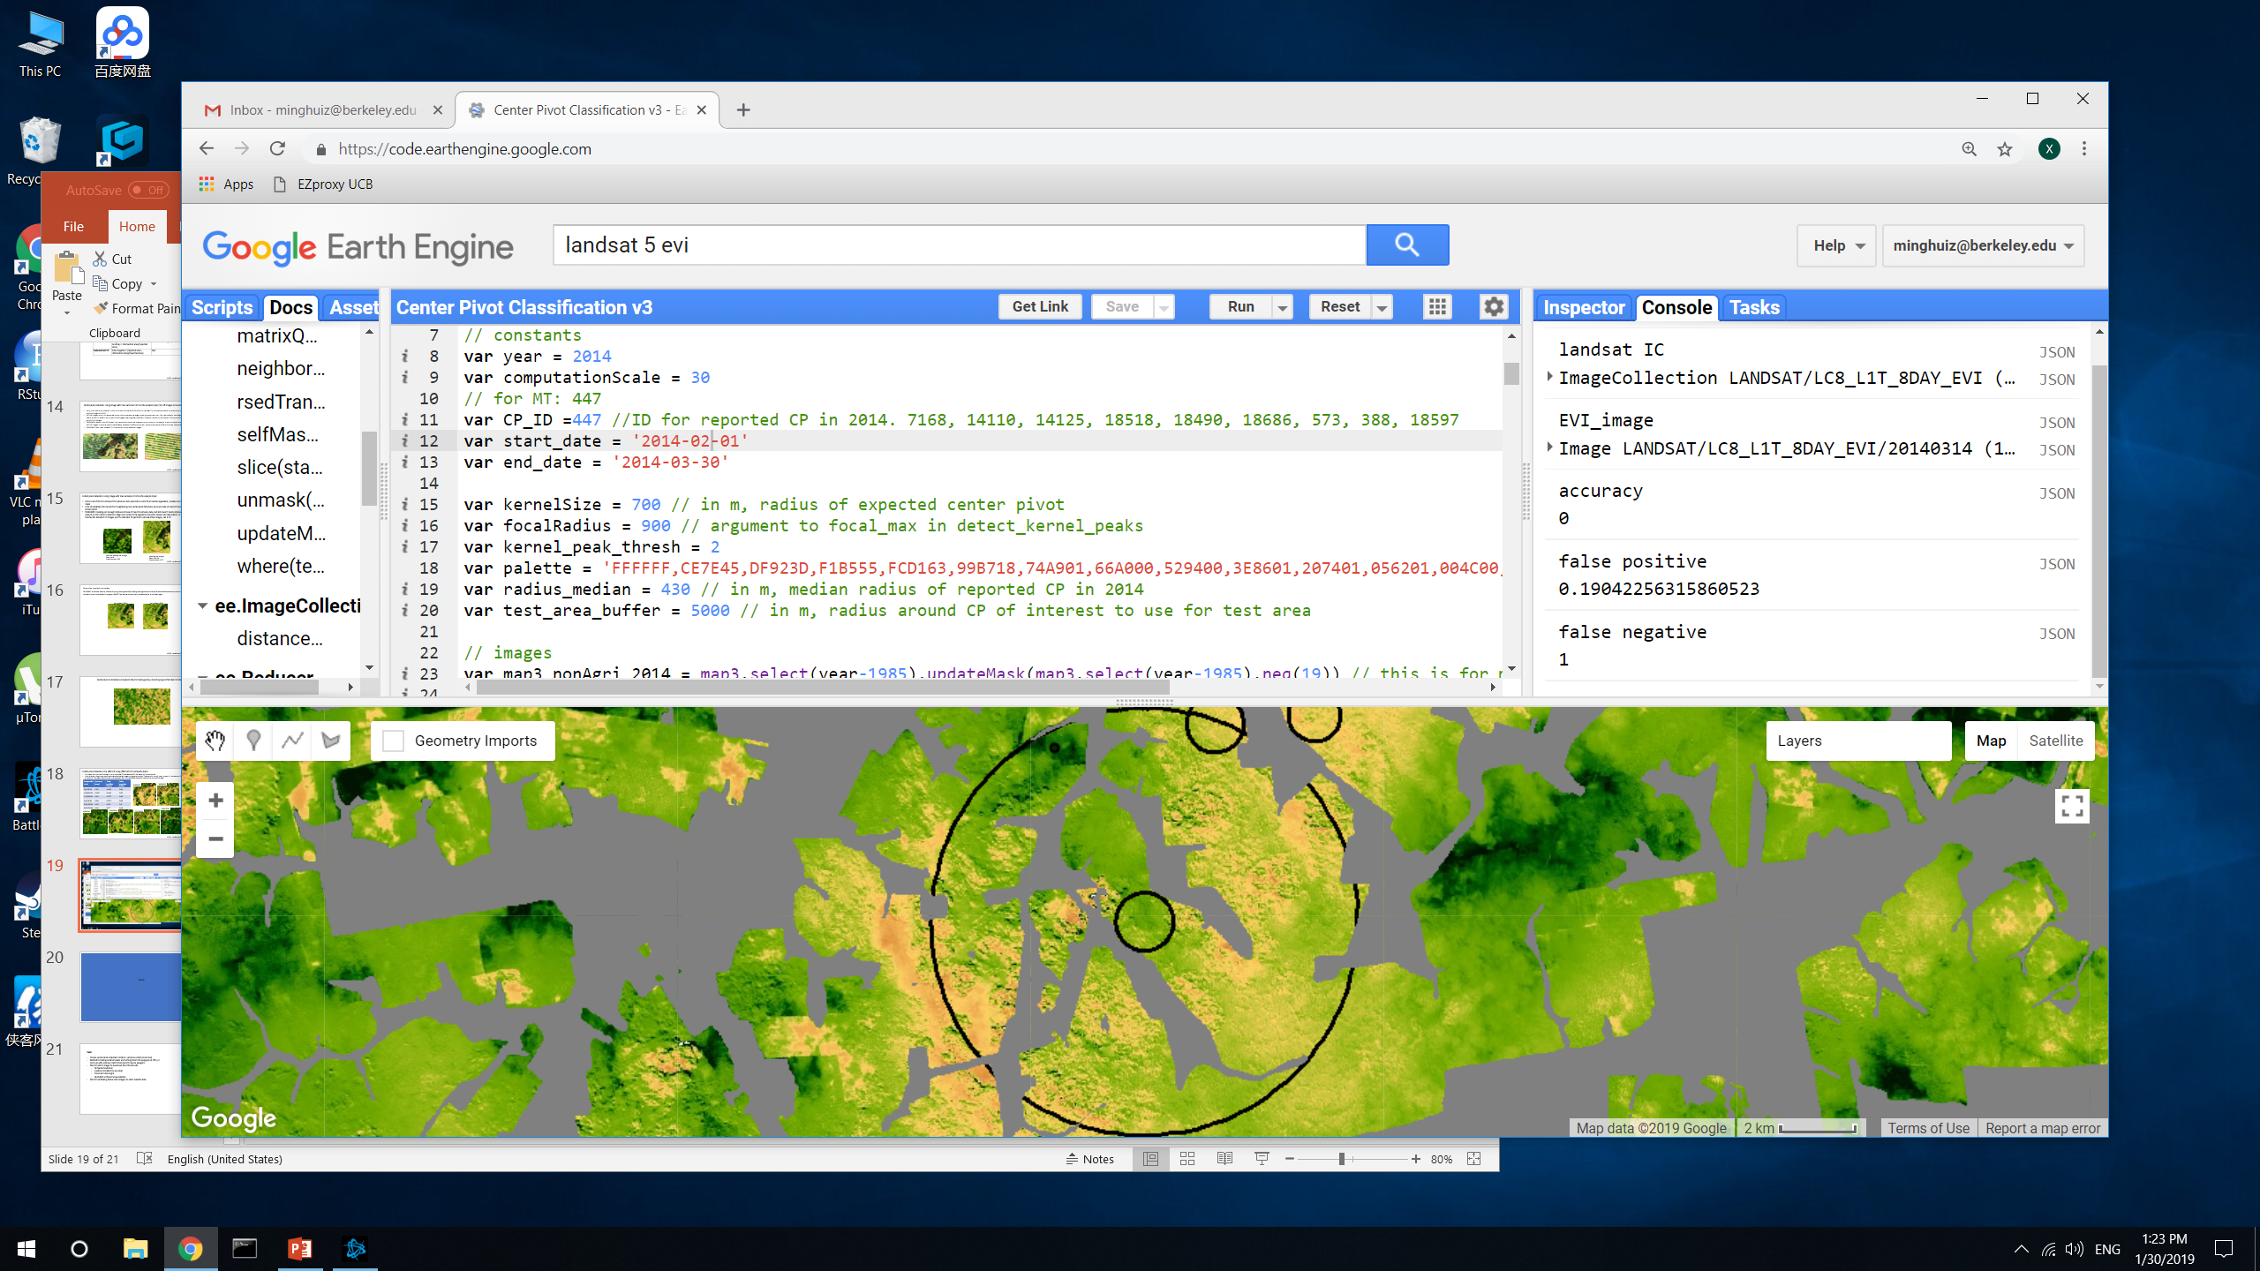



Center pivot detection: the effect of using different EVI composite dates
For these, took out map3 nonagri in both reported CP and detected CP. Accuracy is in terms of area
Unlike previous example, this area in Mato Grosso has a lot of false positives because of heterogeneous land cover. Gray is natural vegetation, masked out.
Composite date | Accuracy (area) | False positive (area) | False negative (area)
6/2/2014 | 0 | 1.14 | 1
4/15/2014 | 0 | 5.05 | 1
3/14/2014 | 0 | 0.19 | 1
1/9/2014 | 0 | 0 | 1
10/24/2013 | 0 | 1.2 | 1
8/5/2013 | 0 | 1.1 | 1
6/2/2014
4/5/2014
3/14/2014
1/9/2014
10/24/2013
8/5/2013
In GEE: LandCover/Center Pivot Classification v3

Slide 25
Center pivot detection: just use 2014’s reported CP to get only nonirrigated pixels during or before 2014
Reasons:
False positives are very high in places with farmland and no center pivot because of heterogeneity of fields; this can’t be masked out with map3
False negatives are high because center pivots might be staggered so there’s no ‘yellow’ space between the ‘green’
Maximum EVI variance image over various time spans never produce an acceptable result
If overlay areas that are consistently classified as center pivot over the course of the year to gain ‘confidence’ in the result, it won’t work because the unique color of center pivots is only obvious for short spans of time; and there is no single span of time for which we have higher confidence
Scaling up from 25km2 circles to all of Brazil will take weeks (e.g. need to figure out how to avoid false detections at edges of the image segments)
Kernel sizes are uncertain; could base kernel size off of 2014’s local center pivot radii but that would make it harder to scale up
Maybe there are more center pivot data for other years – ask Avery, Gabriel
In GEE: LandCover/Center Pivot Classification v3

Slide 26
Next

Slide 27
Next:
Connect Planet to GEE
Produce validation dataset out of this month’s image downloads) (SC vs DC; planting and harvest date)
Plan for calibrating Planet Labs imagery to other satellite data

Slide 28
Questions for Iryna
Center pivot classification given the challenges of Brazil
Calibration of Planet Scope and Rapid Eye images
Automated detection of single vs double cropped soy; of planting and harvest time
Ways to discern soy from other agri

